Slide 1
System Administration Warehouse Setup
WMS Guide

Slide 2
Table of Contents
Warehouse Options………………………………………………………………………………………………………..……………………….5
Release Mobile Locks & Release Exclusive Locks Options………………………………………………………..53
Sections.…………………………………………………………………..……………………………………………………………………………54
Mobile Equipment…….………………………..…………………………………………………………………………………..…………….60
Mobile Equipment Details………………….…………………………………………………………………………………..……………..73
Warehouse Searches………………………………………….………………………………………………………………..………………..77
Warehouse Searches Details……………………………………………………………………………………………..…………………..91
Hold Codes.…………………………………………………………………………………………………………..……………………………….95
Reasons.…………………………………………….…………………………………………………………………..……………………………103
Storage Rules.…………………………….…………………………………………………………………………..…………………………...111
Storage Rule Details.………………………………….…………………………………………………………..…………………………….126

Slide 3
Table of Contents
Container Types………………………………………………………………………………………………………..…………………………131
Container Selection Codes………………………………………………………………………………………..…………………………146
Container Selection Code Details………………………………………………………………………………..……………………….159
Stations…………………………………….………………………………………………………………………………..……………………….163
Station Devices…………………………………………………….……………………………………………………..……………………….180
Areas…………………………………………………….……………………………………………………………………..………………………189
Area Confirmations…………………………………………………….……………………………………………………..…………………212
WMS Users…………………………………………………….…………..………………………………………………..………………………221
Document Format Definitions for WMS………………..……………………………………………………..………………………223
Route Points………………………………………………………….……………………………………………………..………………………233

Slide 4
Table of Contents
Route Work…………………………………….…………………….……………………………………………………..………………………241
Route Move Instructions………………..…………………………………………………………………………..……………………….252
Routing Simulator…………………………………………….…………………………………………..……………………….256
Locations …………………………………………….…………………………………………..………………………………………………….261
Carrier Services…………………………………………….…………………………………………..……………………….………………..282
Sites…………………………………………….…………………………………………..………………………………………….………………295
Quarantine Reasons…………………………………………….…………………………………………..……………………….…………313
Item Aliases…………………………………………….…………………………………………..……………………….….……………….…321
Organizations…………………………………………….…………………………………………..…………………………………………….330
Zones…………………………………………….…………………………………………..…………………………………………………………339

Slide 5
Warehouse Options
Back to the Table of Contents

Slide 6
Warehouse Options
The Warehouse Options resource includes parameters that are initially populated during the WMS installation procedure.
This resource contains general information such as the material selection parameters, default values for customer and vendor returns, definition of automatic cycle counts, definition of several system-wide parameters, etc.
This resource is used to maintain the parameters established in the warehouse, create new warehouses in the database and Query the parameters defined in the warehouse options table.
Since multiple WMS warehouses may be set up in the same database, when launching this resource, you are only given the warehouse record tied to your session parameter.

Slide 7
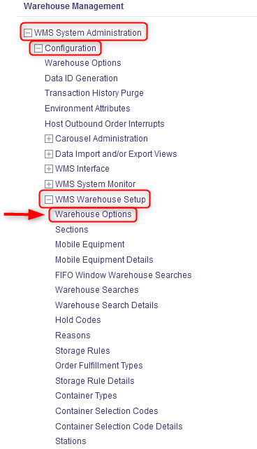
Warehouse Options
With a desktop computer, select the WMS System Administration resource.
Under WMS System Administration, click on Configuration.
Under Configuration, click on WMS Warehouse Setup.
Under WMS Warehouse Setup, click on Warehouse Options.

Slide 8
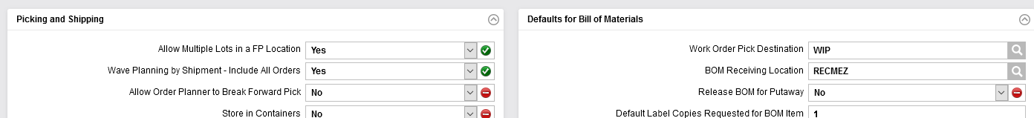
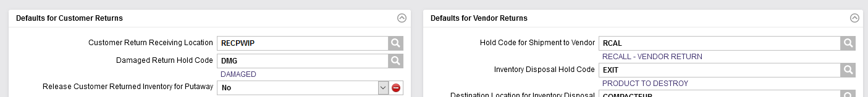
Warehouse Options
From the new window, six sections will appear: Ship From, Receiving, Picking and Shipping, Defaults for Bill of Materials, Defaults for Customer Returns and Defaults for Vendor Returns.

Slide 9
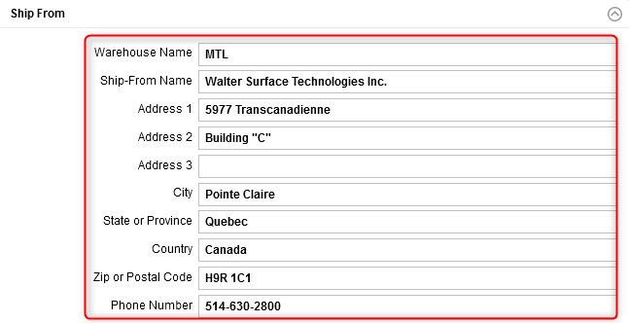
Warehouse Options
Complete the Ship From section for the fields shown below. An explanation of the fields is given in the next slide.

Slide 10
Warehouse Options
(Continued)
Field | Explanation
Warehouse Name | The name of the given warehouse.
Ship-From Name* | The company name
Address 1 | The ship-from's first line of address.
Address 2 | The ship-from's second line of address.
Address 3 | The ship-from's third line of address.
City* | The city in which the warehouse is located.
State or Province* | The state or province in which the warehouse is located.
Country* | The country in which the warehouse is located.
Zip or Postal Code* | The zip or postal code associated with the warehouse location.
Phone Number* | The warehouse's phone number.
*These fields will appear on all report, list, and label headers.

Slide 11
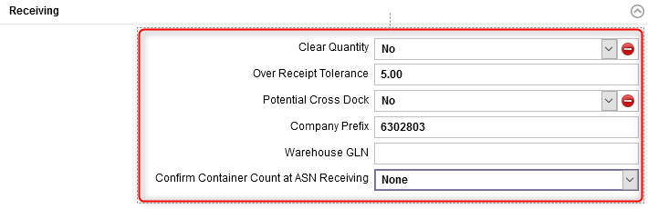
Warehouse Options
Complete the Receiving section for the fields shown below. An explanation of the fields is given in the next slides.

Slide 12
Warehouse Options
(Continued)
Field | Explanation
Clear Quantity | Affects inbound order receiving on a mobile computer: Yes indicates that the quantity to receive is hidden. In this case, when the cursor is moved to the Quantity field, the field will appear to be blank. If nothing is changed in that field, then when the cursor is moved to another field, the user is forced to enter a quantity. No indicates that the quantity to receive is displayed. In this case, when the cursor is moved to the Quantity field, the number is displayed without any trailing zeroes after the decimal point.
Over Receipt Tolerance | The percentage by which a receipt quantity may exceed the inbound order quantity.
Potential Cross Dock | Yes indicates that potential cross docking is enabled for this system. No indicates that potential cross docking is not enabled.

Slide 13
Warehouse Options
(Continued)
Field | Explanation
Company Prefix | This field is a unique number assigned to a company by GS1 US to serve as the foundation for generating GS1 identifiers (e.g. GTIN). This field is used in generating the UCC128 / SSCC-18 bar code when printing shipping labels for EDI customers.
Warehouse GLN | The Global Location Number (GLN) for the Ship From location of the warehouse set up in the warehouse options table.
Confirm Container Count at ASN Receiving | A flag that indicates whether or not the user must enter the quantity received during the ASN receiving process. None indicates that the user is not required to enter the quantity received and that the values displayed on the receipt are based on the ASN. Force indicates that the user must enter the quantity received. The quantity entered by the user is compared to the ASN to ensure that the values match. If the values do not match, an error message is displayed and the receipt is not completed. Optional indicates that the user may enter the quantity received or choose to skip this step. Similarly to the Force option, if the values entered do not match with the ASN, an error message is displayed and the receipt is not completed.

Slide 14
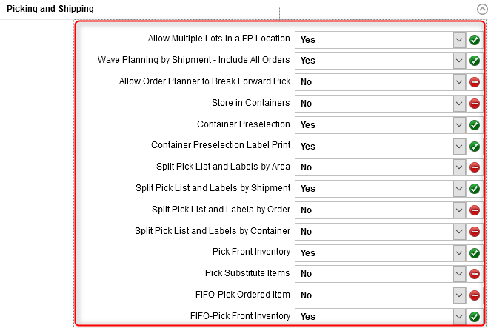
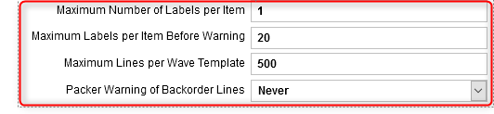
Warehouse Options
Complete the Picking and Shipping section for the fields shown below. An explanation of the fields is given in the next slides.

Slide 15
Warehouse Options
(Continued)
Field | Explanation
Allow Multiple Lots in a FP Location | No indicates that the system will not allow multiple lots in a forward pick location. Yes indicates that the system will allow multiple lots in a forward pick location.
Wave Planning by Shipment - Include All Orders | Yes indicates that while querying on an order, if other orders exist with the same shipment number, then display those also. No indicates that only the specific order queried upon should be retrieved, regardless of whether or not it is part of a multi-order shipment.
Allow Order Planner to Break Forward Pick | Yes indicates that material in a forward pick location can be broken when picking (or replenishing) from a forward pick location. No indicates that material in a forward pick location cannot be broken.
Store in Containers | Yes indicates that the storage logic will look for a suitable location for a non-transport container based on the container dimensions and the storage rule of the inventory found in the container. When this flag is set to Yes, the system does not perform a preverification for possible sources of replenishment. No indicates that the system does not store a non-transport container, nor will it search for inventory within any manually stored non-transport containers.

Slide 16
Warehouse Options
(Continued)
Field | Explanation
Container Preselection | This flag controls the ability to have the WMS preselect the optimal shipping container size into which an outbound order is picked and packed. Yes indicates that the pick container preselection algorithm is implemented on a system-wide basis. If set to Yes, the system will preselect the optimal container type to be used for order picking based on the table-driven rules defined in the container selection tables. No indicates that the pick container preselection algorithm is not implemented.
Container Preselection Label Print | A flag that indicates whether or not CPRE labels will be printed. If Yes is selected, the the CPRE labels will be printed. The value of this flag depends on the value of the Container Preselection flag. If the Container Preselection flag is set to No, this flag cannot be set to Yes. If the Container Preselection flag is set to Yes, this flag may be set to either Yes or No.

Slide 17
Warehouse Options
(Continued)
Field | Explanation
Split Pick List and Labels by Area | When releasing a wave via the Wave Management resource, select Yes to indicate that you wish to generate the pick list and pick labels by area for the orders selected. Otherwise, select No.
Split Pick List and Labels by Shipment | When releasing a wave via the Wave Management resource, select Yes to indicate that you wish to generate the pick list and pick labels by shipment for the orders selected. Otherwise, select No.
Split Pick List and Labels by Order | When releasing a wave via the Wave Management resource, select Yes to indicate that you wish to generate the pick list and pick labels by order for the orders selected. Otherwise, select No.
Split Pick List and Labels by Container | When releasing a wave via the Wave Management resource, select Yes to indicate that you wish to generate the pick list and pick labels by container for the orders selected. Otherwise, select No. If the Split Pick List and Labels by Area field was also set to Yes, the pick list or pick labels generated will automatically be generated separately for each container and area combination.

Slide 18
Warehouse Options
(Continued)
Field | Explanation
Pick Front Inventory | This applicable when inventory is found in a FIFO or LIFO location. Yes indicates that the order scheduler will look for the front inventory in a location after it has found valid inventory to use in that location. No indicates that the order scheduler will not look for the front inventory. This will improve the speed in systems not concerned with picking from the front of locations. If this flag is set to Yes, then when the WMS selects an inventory record during the inventory selection process based on the warehouse search path, the system will additionally sort all of the item's inventory records within the chosen location by last move date and reselect a new inventory record within the location. This flag can be overruled if an item's Apply Forward Pick FEFO Logic flag is set to Yes.
Pick Substitute Items | This is used to find inventory quantities after cycling through the search method sequence or when the item or package details are inadequate to fill the demand. Yes indicates that picking of substitute material is allowed. No indicates that the order scheduler will not look for substitutes. This flag can be overruled if an item's Apply Forward Pick FEFO Logic flag is set to Yes.

Slide 19
Warehouse Options
(Continued)
Field | Explanation
FIFO-Pick Ordered Item | This is used in conjunction with the FIFO Window Warehouse Search resource to ensure that inventory found in the search matches the original item. This flag is necessary when searching for substitute inventory. Yes indicates that the order scheduler will look for the original order line item when looking at the FIFO Pick Window for a substitute item. No indicates that the order scheduler will not look for the original order line item/package code.
FIFO-Pick Front Inventory | This is used by the FIFO window warehouse search logic to find inventory that is X days older than the selected inventory. This triggers the front inventory logic. Yes indicates that the order scheduler will look for the oldest front inventory in a location, after it has found valid older inventory to use in that location. No indicates that the order scheduler will not look for the oldest front inventory. The system will allocate against the front-most unit load unless it has a receipt date and time which is more than N days older then the oldest unit load within the storage location.

Slide 20
Warehouse Options
(Continued)
Field | Explanation
Maximum Number of Labels per Item | The number of pick labels printed for an item, tag, and UOM combination.
Maximum Labels per Item Before Warning | The maximum number of labels for a single item for each order line. This is used by the Outbound Order Planning resource. When the maximum is exceeded, then prior to the wave's release, a warning message is displayed giving the user the option to continue or to change the settings.
Maximum Lines per Wave Template | The default value for the number of detail lines that are allowed to appear in a single wave. This field determines the maximum number of order lines allowed.
Packer Warning of Backorder Lines | A flag that controls the error message displayed in the Ready to Ship column of the Shipping Activities resource. Never indicates that a warning message is not displayed when there are backordered lines for any order tied to the shipment. Always indicates that an error message which warns the user that backordered lines exist for any order tied to the shipment is displayed.

Slide 21
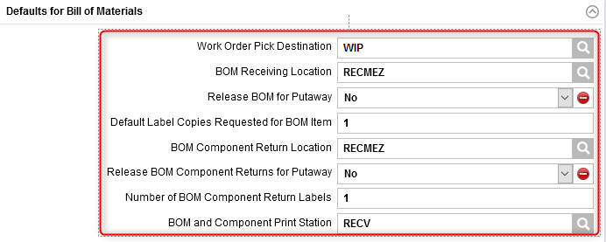
Warehouse Options
Complete the Defaults for Bill of Materials section for the fields shown below. An explanation of the fields is given in the next slide.

Slide 22
Warehouse Options
(Continued)
Field | Explanation
Work Order Pick Destination | All work orders are assigned this location as the initial pick destination. It may be overridden in the Outbound Order Planning resource.
BOM Receiving Location | The receiving location for work order bills of material (BOM) received.
Release BOM for Putaway | Select Yes to indicate that work order BOM shall be released for putaway. Otherwise, select No.
Default Label Copies Requested for BOM Item | The default number of copies presented when requesting labels for work order BOM components.
BOM Component Return Location | The return location for unused work order components.
Release BOM Component Returns for Putaway | Select Yes to indicate that unused work order component returns shall be released for putaway. Otherwise, select No. A value of No indicates that unused work order component returns shall not be released for putaway.
Number of BOM Component Return Labels | The default number of copies presented when requesting labels for unused work order components.
BOM and Component Print Station | The station to which any required paperwork or labels for BOM item or BOM printing station component returns are to be directed.

Slide 23
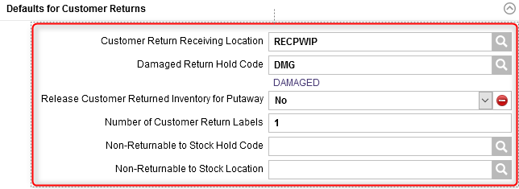
Warehouse Options
Complete the Defaults for Customer Returns section for the fields shown below. An explanation of the fields is given in the next slide.

Slide 24
Warehouse Options
(Continued)
Field | Explanation
Customer Return Receiving Location | This location identifies the designated receiving location for inventory related to a customer return.
Damaged Return Hold Code | This hold code is automatically assigned to damaged inventory related to a customer return.
Release Customer Returned Inventory for Putaway | This field is used if the release for putaway has not been specified on the DMS. Select Yes to indicate that customer return items received should be released for putaway after the receipt has been processed. Otherwise, select No.
Number of Customer Return Labels | The number of labels to be printed when receiving inventory related to a customer return. This field is used if the number of labels has not been specified on the DMS.
Non-Returnable to Stock Hold Code | The non-returnable to stock hold code in the Express Returns resource. When used, it will be applied to any item identified as a non-returnable to stock item in the items table.
Non-Returnable to Stock Location | The non-returnable to stock disposal location. When used, it will be populated as the final destination location for the item when processing an Express Returns. The product will be stored directly in that location when the Express Returns is released. Any location type can be used for the disposal location with the exception of a hold or an exit location.

Slide 25
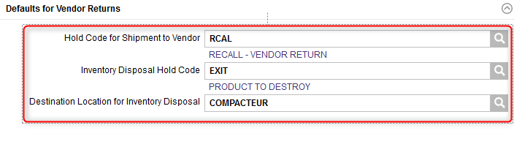
Warehouse Options
Complete the Defaults for Vendor Returns section for the fields shown below. An explanation of the fields is given in the next slide.

Slide 26
Warehouse Options
(Continued)
Field | Explanation
Hold Code for Shipment to Vendor | This hold code is used to designate damaged inventory (tags) that are destined for disposal (i.e. shipped back to the vendor). This is used to indicate how repaired inventory related to a vendor return is to be processed.
Inventory Disposal Hold Code | This hold code is used to designate damaged inventory (tags) destined for disposal. This hold code is only used for vendor returns.This is used to indicate how repaired inventory related to a vendor return is to be processed.
Destination Location for Inventory Disposal | The location to which inventory is taken for disposal. An exit location that identifies the pick destination. This location only applies to items included in a vendor return with a specific hold code.

Slide 27
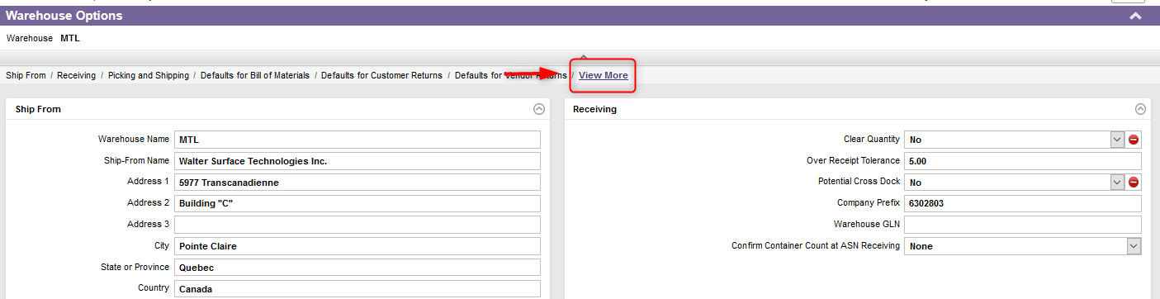
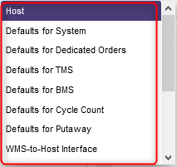
Warehouse Options
By clicking on "View More" at the top right of the resource, various other parameters can be configured: Host, Defaults for System, Defaults for Dedicated Orders, Defaults for TMS, Default for BMS, Defaults for Cycle Count, Defaults for Putaway, WMS-to-Host Interface, Shipment Definition Automatic Adjustment, Group by Ship-To, Group by Bill-To and Group by Shipment.

Slide 28
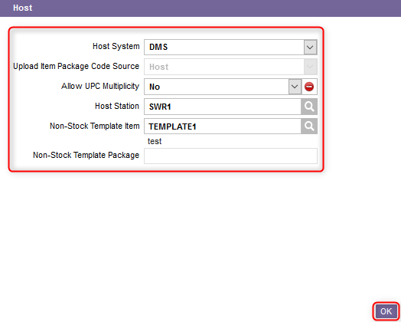
Warehouse Options
Click on Host, complete the section for the fields shown below and click on OK once done. An explanation of the fields is given in the next slide.

Slide 29
Warehouse Options
(Continued)
Field | Explanation
Host System | DMS indicates that fields should be maintainable according to the rules for an interface to EliteSeries DMS. PFE indicates that fields should be maintainable according to the rules for an interface to PointForce. The carrier services table will be maintainable, but the Serial Required flag in the items table will not be maintainable since the PFE interface tracks serial items. Streamline indicates that fields should be maintainable according to the rules for an interface to other host systems. The carrier services table, along with the Serial Required flag in the items table will be maintainable. Other indicates that fields should be maintainable according to the rules for an interface to other host systems. The carrier services table, along with the Serial Required flag in the items table will be maintainable.
Upload Item Package Code Source | A flag that indicates the upload item package code source: Host indicates that package codes for upload items can only be created by the host. WMS indicates that package codes for upload items can only be created by the WMS. Note that when the host system is DMS or Streamline, the value is defaulted to Host and is restricted. The item and package codes for upload items are created by the DMS and Streamline and not by the WMS.

Slide 30
Warehouse Options
(Continued)
Field | Explanation
Allow UPC Multiplicity | Yes indicates that the item UPC will not be validated for uniqueness, which means that the same UPC can be used for more than one item. No indicates that the item UPC must be unique.
Host Station | This sets the warehouse search path for all outbound orders. It also specifies the station at which lists and reports are to be printed. Printers may be defined for any station; the host station simply defines at which station automatically generated commands from a desktop computer are to be printed.
Non-Stock Template Item | This is a valid WMS item number defined in the items table. This is used by the WMS interface Download Scheduler and serves as a template that provides the information needed to create new non-stock items when received. The GS1 bar code can be scanned into the field to display the record tied to that item.

Slide 31
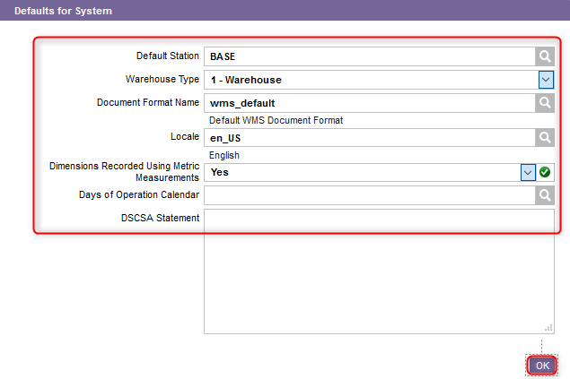
Warehouse Options
Click on Defaults for System, complete the section for the fields shown below and click on OK once done. An explanation of the fields is given in the next slide.

Slide 32
Warehouse Options
(Continued)
Field | Explanation
Default Station | This is the station assigned to all transactions received from the DMS. Most significantly, it sets the default warehouse search path for all WMS outbound orders.
Warehouse Type | The warehouse type for the warehouse which is either Warehouse (default) or Hospital Pharmacy.
Document Format Name | This is the document format to be used by the WMS if none is specified on the outbound order header or the carrier service. The shipping label, container label, and pick label formats can all be specified on an order-by-order basis.
Locale | This is the unique identifier for the locale of the warehouse. The key determines the language of the printed reports and documents to be used.
Dimensions Recorded Using Metric Measurements | Yes indicates that the system should make volumetric calculations based on metric dimensions (item dimensions are assumed to be entered in centimeters and the volume is calculated as cubic meters). No indicates that the system should make volumetric calculations based on imperial dimensions (item dimensions are assumed to be entered in inches and the volume is calculated as cubic feet).
Days of Operation Calendar | This is the company's operating days and is used to determine the days during which a company is open for business.
DSCSA Statement | The Drug Supply Chain Security Act (DSCSA) statement according to the new drug law which indicates that the product awaiting to be shipped conforms to the the DSCSA law.

Slide 33
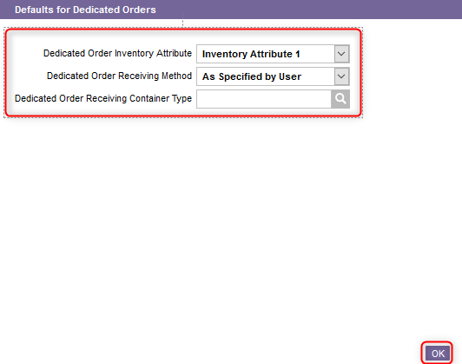
Warehouse Options
Click on Defaults for Dedicated Orders, complete the section for the fields shown below and click on OK once done. An explanation of the fields is given in the next slide.

Slide 34
Warehouse Options
(Continued)
Field | Explanation
Dedicated Order Inventory Attribute | Indicate Inventory Attribute 1, Inventory Attribute 2 or Inventory Attribute 3 depending on whether you want that Inventory Attribute 1/2/3 indicates that the inventory Inventory Attribute 1/213 field should be used for tracking inventory belonging to delivery forwarding dedicated orders. The dedicated outbound order identifier value will be assigned to the Inventory Attribute 1/2/3 field.
Dedicated Order Receiving Method | Item Details Not Required indicates that a dedicated order will be automatically received in full after the user assigns a container number to the dedicated order. This value should be specified to simplify the receiving process if for the majority of dedicated orders there will never be more than one package per order, lot numbers will not be required for any of the items in the order, and each item quantity will be less than a full load. However, the system will automatically direct the user to perform detailed receiving when the user indicates that there is more than one package, when lot numbers are required, or when a full load quantity is encountered. Item Details Required indicates that the user must always perform detailed receiving for dedicated orders. This value should be specified if it will be a regular occurrence that more than one package is received per order, lot numbers are required for some of the items in the order, some of the item quantities are equal to or greater than a full load, and/or it is corporate policy that all deliveries must be verified at receiving. As Specified by User indicates that the user can choose to perform either summary or detailed receiving for each order.

Slide 35
Warehouse Options
(Continued)
Field | Explanation
Dedicated Order Receiving Container Type | The container type to be used when assigning container numbers to dedicated order packages during the receiving process. The packages being received can have a wide variety of dimensions and weights which may not match any of the standard container types used within the warehouse, so this value is assumed to represent a miscellaneous container type. This miscellaneous container type should be assigned arbitrary dimension and weight values.

Slide 36
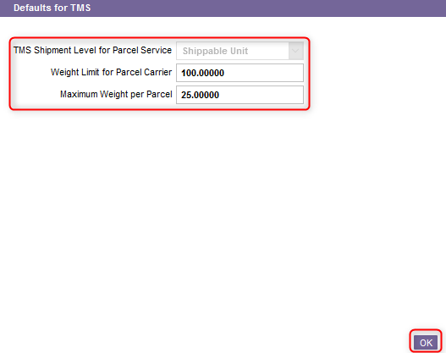
Warehouse Options
Click on Defaults for TMS, complete the section for the fields shown below and click on OK once done. An explanation of the fields is given in the next slide.

Slide 37
Warehouse Options
(Continued)
Field | Explanation
TMS Shipment Level for Parcel Service | Shipment (default) indicates that if the TMS interface is enabled, a WMS shipment is equivalent to a shipment in the TMS under normal circumstances. Each WMS shippable unit belonging to the WMS shipment is equivalent to a shipment package in the TMS. There may be exceptions, however, which may necessitate multiple TMS shipments for the same WMS shipment. Shippable Unit indicates that if the TMS interface is enabled, an individual WMS shippable unit is equivalent to a shipment and shipment package combination in the TMS. Note that the value of this field cannot be changed when a record exists in the shippable units table.
Weight Limit for Parcel Carrier | Outbound orders with a total weight exceeding this value will be rated as a single package when using the TMS Route Now action in Outbound Order Planning. This increases the probability that TMS will select an LTL carrier.
Maximum Weight per Parcel | This value determines how an outbound order will be split when attempting to rate it using a parcel service. It contains the maximum weight allowed for each package when using the TMS Route Now action in Outbound Order Planning.

Slide 38
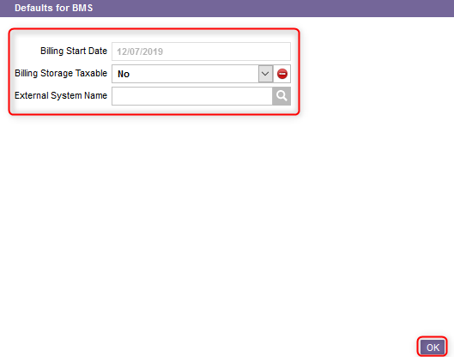
Warehouse Options
Click on Defaults for BMS, complete the section for the fields shown below and click on OK once done. An explanation of the fields is given in the next slide.

Slide 39
Warehouse Options
(Continued)
Field | Explanation
Billing Start Date | The start date for billing.
Billing Storage Taxable | A flag that indicates if taxes are to be calculated for the storage billing charges in the BMS: No indicates that no taxes will be calculated for the storage billing charges in the BMS. Yes indicates that the BMS will add taxes to the storage billing charges when invoicing. The tax rate will be based on the province or state and country of the warehouse in the WMS as set up in the BMS tax tables.
External System Name | The system name used to link to the common business object table in metadata where the country and state or province codes are stored with the related tax codes and rates.

Slide 40
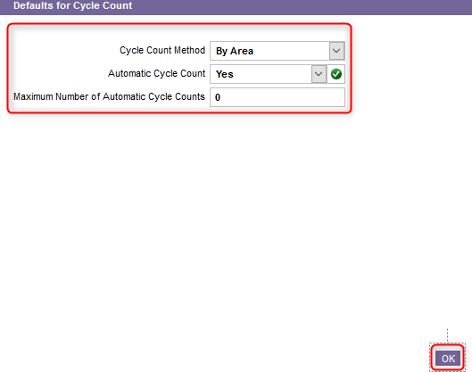
Warehouse Options
Click on Defaults for Cycle Count, complete the section for the fields shown below and click on OK once done. An explanation of the fields is given in the next slide.

Slide 41
Warehouse Options
(Continued)
Field | Explanation
Cycle Count Method | This is the method used for automatically scheduled cycle counts: By Area indicates that the system will use the cycle count frequencies in the areas table to determine the cycle counts to be scheduled. Commands are generated for all locations in an area that have not been cycle counted within the number of days specified by the cycle count frequency field in the areas table. Both by Area and Item indicates that the system will use the cycle count frequencies in both the items table and the areas table to determine the cycle counts to be scheduled. By Item indicates that the system will use the cycle count frequencies in the items table to determine the cycle counts to be scheduled. Cycle counts commands are generated for all locations for which the system shows inventory matching the item (if a cycle count has not been generated in that location within the number of days specified by the cycle count frequency field in the items table).
Automatic Cycle Count | Yes indicates that automatic cycle counts may be generated. No disables the automatic generation of cycle counts.
Maximum Number of Automatic Cycle Counts | The maximum number of cycle counts that may be generated automatically on a given day.

Slide 42
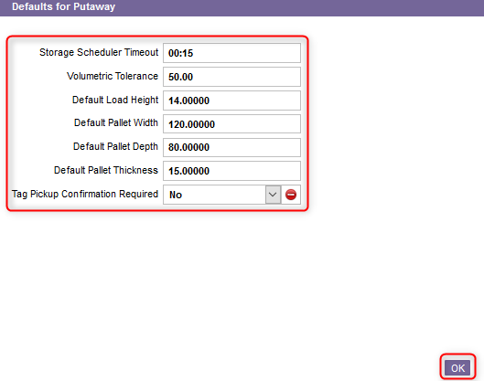
Warehouse Options
Click on Defaults for Putaway, complete the section for the fields shown below and click on OK once done. An explanation of the fields is given in the next slide.

Slide 43
Warehouse Options
(Continued)
Field | Explanation
Storage Scheduler Timeout | The amount of time the system should spend looking for a storage location. The current location of the product is the selected location when the Storage Scheduler times out. If all storage locations are filled, this may be set to 0 to prevent the system from wasting time seeking a storage location.
Volumetric Tolerance | A percentage that is applied to a container's calculated volume to allow for irregularities, and only when the container type's Add Dimensions is Yes. This is used in determining location selection.
Default Load Height
Default Pallet Width
Default Pallet Depth
Default Pallet Thickness
Tag Pickup Confirmation Required | A flag that indicates whether or not the user needs to confirm each tag being stored. Yes indicates that the user must confirm each tag being stored. No indicates that when storing multiple tags from the same container or using the multi-tag store, the user must confirm all tags with the exception of the final tag. If only one tag is being stored, no tag confirmation is required.

Slide 44
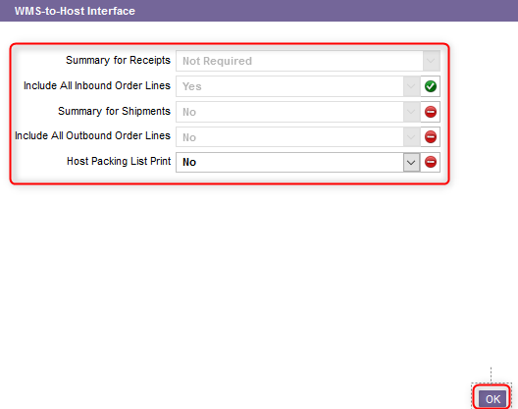
Warehouse Options
Click on WMS-to-Host Interface, complete the section for the fields shown below and click on OK once done. An explanation of the fields is given in the next slide.

Slide 45
Warehouse Options
(Continued)
Field | Explanation
Summary for Receipts | A setting that indicates if the WMS-to-host transaction receipt details should be summarized by inbound order into the WMS-to-host receipt tables. Assigning a non-zero value will result in all WMS-to-host transaction receipt details being set to a status of IHLD - Interface Hold until the appropriate receipt close conditions have been met. When this occurs, the WMS-to-host transaction receipt details will be transferred into the WMS-to-host receipt tables and the WMS-to-host transaction receipt details will be set to a status of SENT. The Is Extracted flag will be set to Yes and the status will be set to RDY - Ready for Transmission on the last WMS-to-host transaction record for the inbound order with a task of RCLS - Receipt Closed, which indicates that the summary table records have been extracted and are ready. A value of 0 indicates that the host system interface will extract the receipt detail records directly from the WMS-to-host transactions table. A value of 1 indicates that the summary table records should be created when each RCLS - Receipt Closed record is inserted into the WMS-to-host transactions table. This results in separate sets of WMS-to-host receipts table records per receipt for the inbound order when concurrent receipts are in process in the WMS. A value of 2 indicates that the summary table records should be created when the last RCLS - Receipt Closed record gets inserted into the WMS-to-host transactions table. This results in a single set of WMS-to-host receipts table records for all receipts for the inbound order when concurrent receipts are in process in the WMS.

Slide 46
Warehouse Options
(Continued)
Field | Explanation
Include All Inbound Order Lines | Select Yes or Not to indicate whether or not the WMS-to-host receipt summary tables should include the inbound order lines that were not received.
Summary for Shipments | A flag that indicates if the WMS-to-host transaction shipment details should be summarized into the WMS-to-host shipment tables when the shipment has been shipped complete. Yes will result in all WMS-to-host transaction shipment details being set to a status of IHLD - Interface Hold until a WMS-to-host transaction record with a task of OSHP - Shipment Completed has been created for the shipment. When this occurs, the WMS-to-host transaction shipment details will be transferred into the WMS-to-host shipment tables and the WMS-to-host transaction shipment details will be set to a status of SENT. The Is Extracted flag will be set to Yes and the status will be set to RDY - Ready for Transmission, for a WMS-to-host transaction record with a task of OSHP - Shipment Completed, which indicates that the summary table records have been extracted and are ready. No indicates that the host system interface will extract the shipment detail records directly from the WMS-to-host transactions table.

Slide 47
Warehouse Options
(Continued)
Field | Explanation
Include All Outbound Order Lines | Select Yes or Not to indicate whether or not the WMS-to-host shipment summary tables should also include the outbound order lines that were not picked and the outbound order lines for which the Host-Backordered flag is set to Yes.
Host Packing List Print | When the WMS is interfaced to a host system other than the DMS, this flag indicates that the user can request that the host system print their packing list in the WMS. This request can be made once the shipment labeling or shipping paperwork process has been completed in the WMS for the order. If the flag is set to Yes and the user requests it, then the WMS will generate an upload transaction (MPAK), which will give the host system the printer name to print out the document in the warehouse. If the flag is set to No, then nothing is done in the WMS and there is no printing of the host packing list in the warehouse.

Slide 48
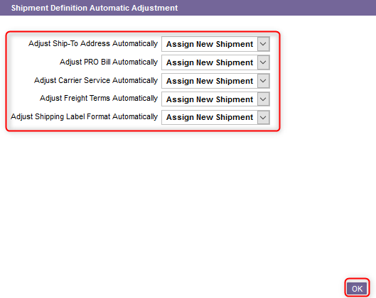
Warehouse Options
Click on Shipment Definition Automatic Adjustment. For the displayed fields, select one of the following two options:
Adjust Automatically indicates that the system will adjust the field automatically in the outbound order so that it matches with the value of the same field in the order well for the same shipment.
Assign New Shipment indicates that the system will not adjust the field in the outbound order.
Click on OK once done.

Slide 49
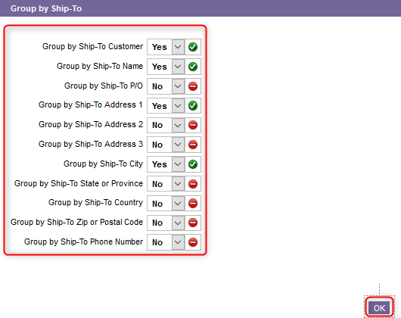
Warehouse Options
Click on Group by Ship-To. For the displayed fields, select Yes to indicate that the system should include this field when attempting to find similar orders in the order well to assign the shipment ID. Otherwise, select No. click on OK once done.

Slide 50
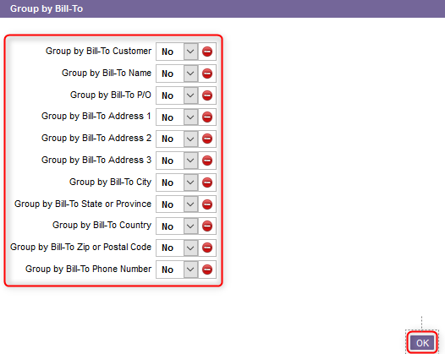
Warehouse Options
Click on Group by Bill-To. For the displayed fields, select Yes to indicate that the system should include this field when attempting to find similar orders in the order well to assign the shipment ID. Otherwise, select No. click on OK once done.

Slide 51
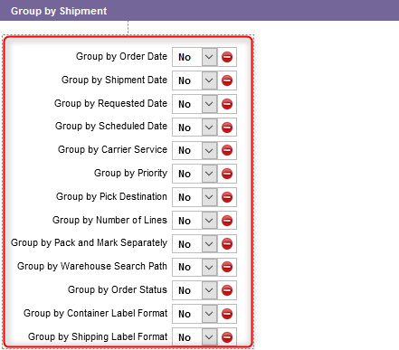
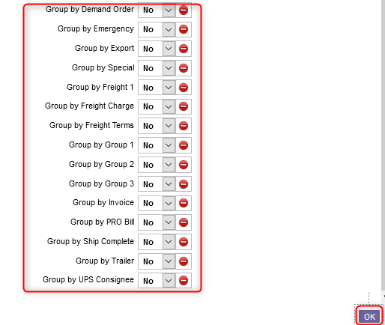
Warehouse Options
Click on Group by Shipment. For the displayed fields, select Yes to indicate that the system should include this field when attempting to find similar orders in the order well to assign the shipment ID. Otherwise, select No. click on OK once done.

Slide 52
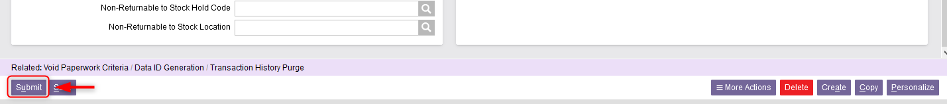
Warehouse Options
Once all the required fields in the sections have been completed, click Submit.
Click on Close to exit the Warehouse Options resource.

Slide 53
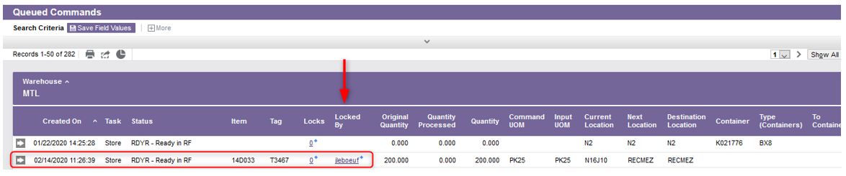
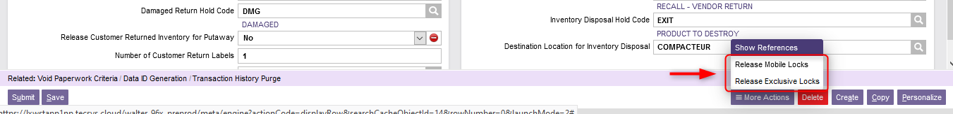
Warehouse Options
Additional Note – Release Mobile Locks & Release Exclusive Locks. If you see that a transaction is blocked in the WMS (using the Queued Commands resource), you can unblock that transaction in the Warehouse Options resource using one of the following two buttons: either Release Mobile Locks to unblock the transaction on a device mobile or Release Exclusive Locks for a desktop computer.

Slide 54
Sections
Back to the Table of Contents

Slide 55
Sections
The Sections resource is used to add, modify, copy, and delete the records in the sections table and query the records in the sections table.
A section may be physical or logical as defined within the WMS. A section is defined in the WMS as a logical attribute of some location or group of locations.
Sections are established primarily for the inventory selection process for selecting inventory to fulfill outbound order lines and forward pick location replenishments.
More than one section is required only if the inventory selection process should consider certain groups of locations as having a higher priority over others.

Slide 56
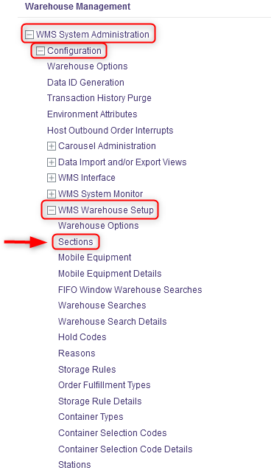
Sections
With a desktop computer, select the WMS System Administration resource.
Under WMS System Administration, click on Configuration.
Under Configuration, click on WMS Warehouse Setup.
Under WMS Warehouse Setup, click on Sections.

Slide 57
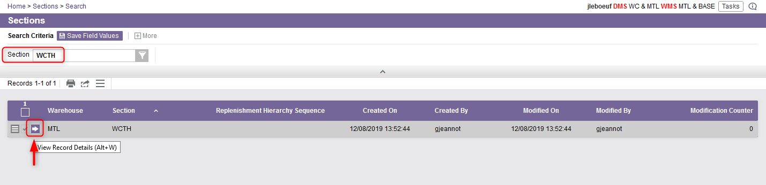
Sections
From the new window, the different sections of the warehouse will be listed.
If required, perform a search to retrieve the section you wish to update and click on View Record Details.

Slide 58
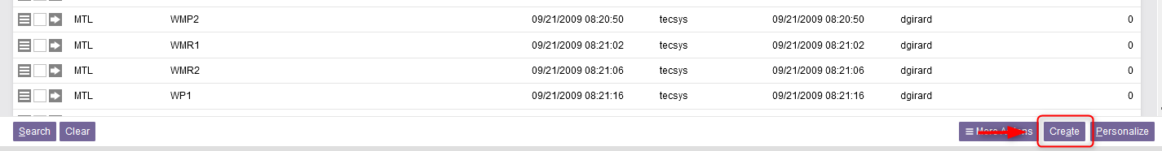
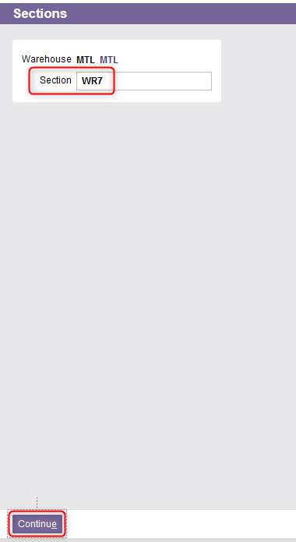
Sections
You also have the option to create a new section. To do this, click on Create at the bottom right of your screen.
From the new window, enter the section name.
Click Continue.

Slide 59
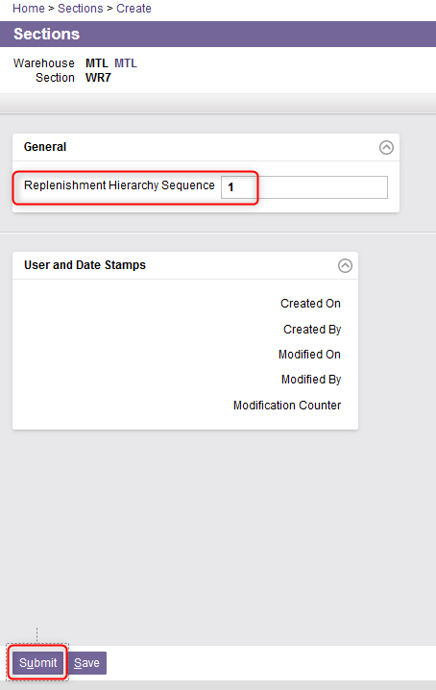
Sections
Whether you have chosen to update a section or create a new one, a new Sections window will appear. From this window, enter or update the Replenishment Hierarchy Sequence field if needed.
This field is optional.
This field corresponds to the replenishment hierarchy sequence of the section.
This is used by the replenishment logic when replenishing a forward pick location from another forward pick location where the UOM configurations for both locations are the same. This is used to prevent a replenishment loop of an FP to another and then back again.
Then Click Submit.

Slide 60
Mobile Equipment
Back to the Table of Contents

Slide 61
Mobile Equipment
The Mobile Equipment resource is used to add, modify, and delete the records in the mobile equipment table and query the records in the mobile equipment table.
The mobile equipment type refers to equipment a user actually uses on the floor, such as a turret truck or a forklift.
Each mobile equipment type is assigned one or more location classes which define the locations the equipment type may access.
When a user signs onto a mobile computer, the user specifies the equipment type being operated.

Slide 62
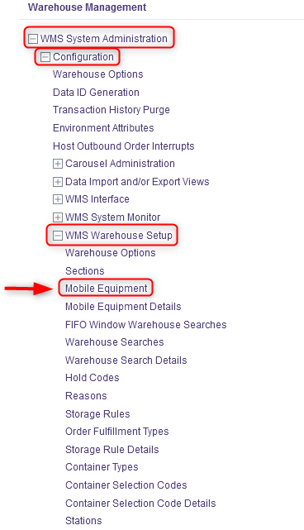
Mobile Equipment
With a desktop computer, select the WMS System Administration resource.
Under WMS System Administration, click on Configuration.
Under Configuration, click on WMS Warehouse Setup.
Under WMS Warehouse Setup, click on Mobile Equipment.

Slide 63
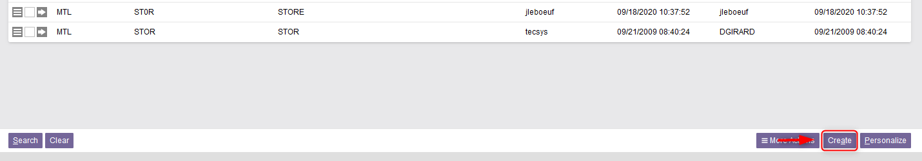
Mobile Equipment
In the new window, the different mobile equipment already configured in the WMS will be listed.
If you want to create a mobile equipment, do this:
6.1 Click on Create at the bottom right of your screen.

Slide 64
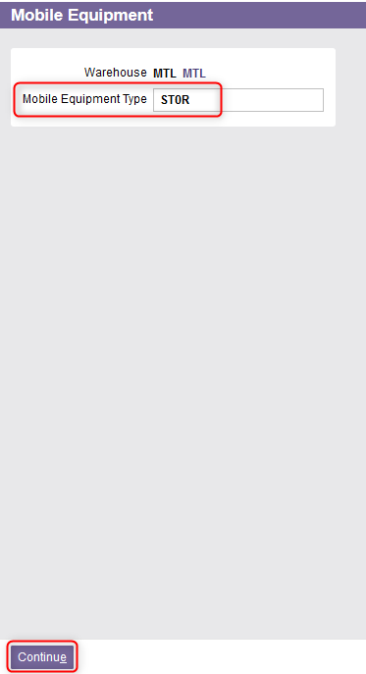
Mobile Equipment
6.2 From the new window, enter the name of the mobile equipment type.
6.3 Click Continue.

Slide 65
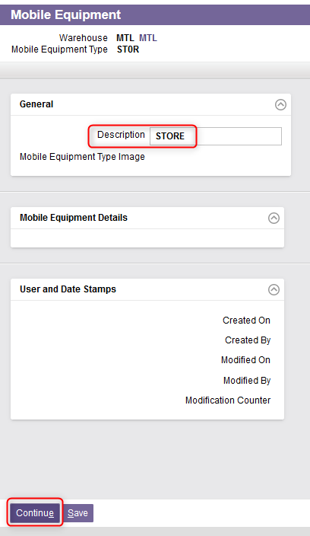
Mobile Equipment
6.4 A new window will appear. Enter a description of the mobile equipment.
6.5 Click on Continue.

Slide 66
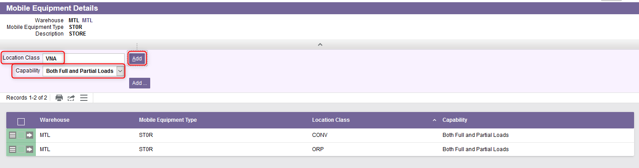
Mobile Equipment
6.6 You will be automatically redirected to the Mobile Equipment Details view. Enter as many location classes as you want by:
Entering the Location Class,
Modifying the Capability if necessary,
Clicking on Add.
An explanation of the fields is given in the next slide.

Slide 67
Mobile Equipment
6.6 (Continued)
Field | Explanation
Location Class | Each mobile equipment type is assigned one or more location classes which define the locations the equipment type may access. The location class refers to the type of storage unit. Each location is assigned a location class.
Capability | Different options are available. At a specific class of location: Full Loads indicates that a full load can be handled for a mobile equipment type, Partial Loads indicates that a partial load can be handled for a mobile equipment type, Both Full and Partial Loads indicates that either a full load or a partial load can be handled for a mobile equipment type.

Slide 68
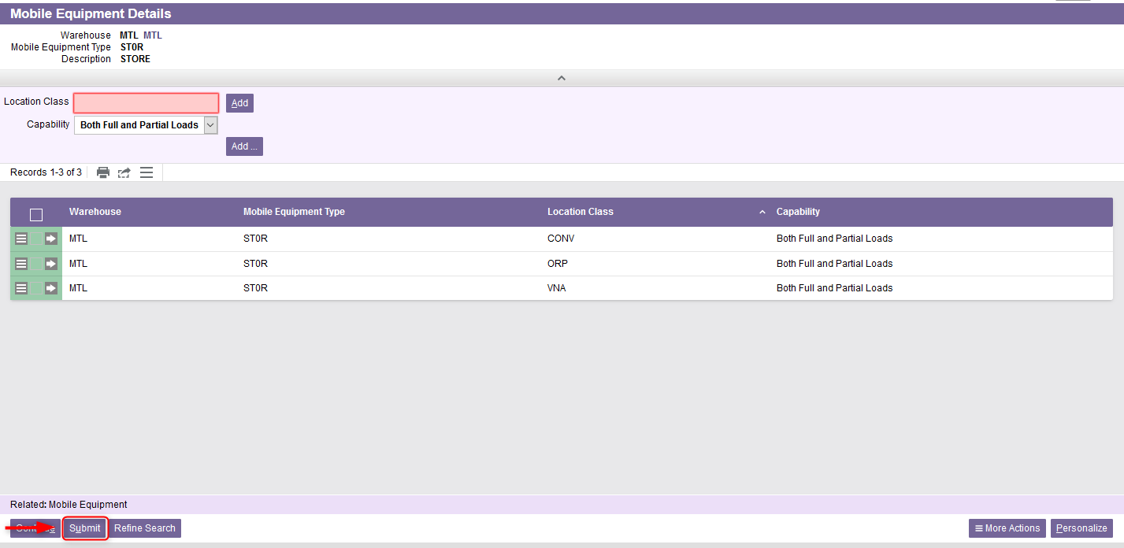
Mobile Equipment
6.7 Once all location classes properly added, click on Submit.

Slide 69
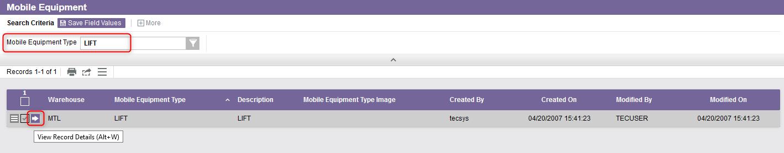
Mobile Equipment
If you want to update a mobile equipment, do this:
7.1 Perform a search to retrieve the mobile equipment you wish to update and click on View Record Details.

Slide 70
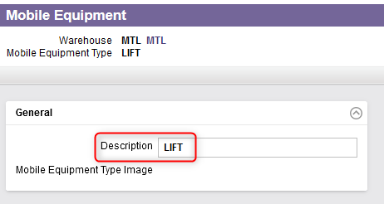
Mobile Equipment
7.2 In the General section, update the description if need be.

Slide 71
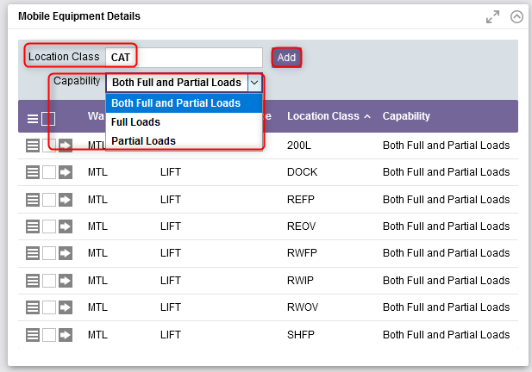
Mobile Equipment
7.3 In the Mobile Equipment Details section, the location classes already associated with the mobile equipment will be listed. You can add more if necessary:
Enter the Location Class,
Modify the Capability if necessary,
Click on Add.

Slide 72
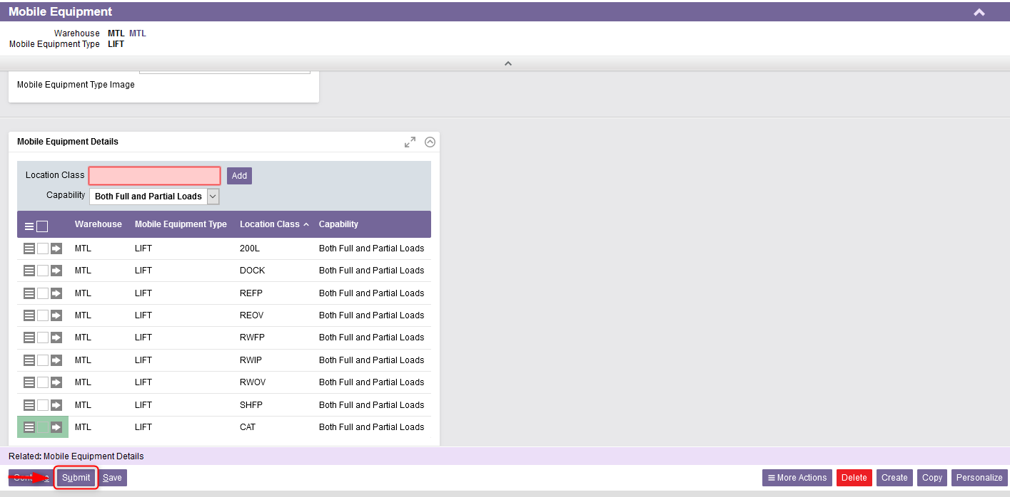
Mobile Equipment
7.4 Once all location classes properly added, click on Submit.

Slide 73
Mobile Equipment Details
Back to the Table of Contents

Slide 74
Mobile Equipment Details
The Mobile Equipment Details resource is used to add, modify, and delete the records in the mobile equipment details table and query the records in the mobile equipment details table.
When launched directly from the portal, this view can be used to edit existing records via Excel or the search results grid. In addition, record-level actions may be executed.
However, the Details page does not allow editing.

Slide 75
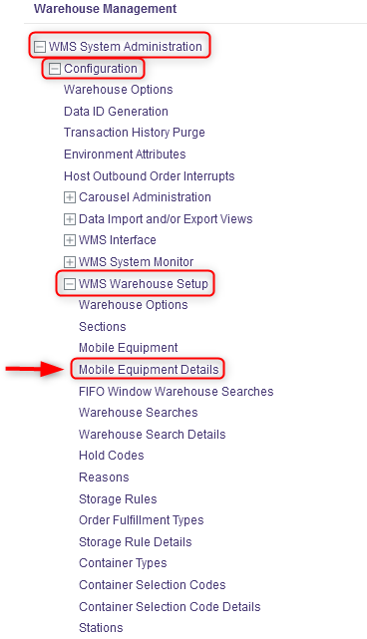
Mobile Equipment Details
With a desktop computer, select the WMS System Administration resource.
Under WMS System Administration, click on Configuration.
Under Configuration, click on WMS Warehouse Setup.
Under WMS Warehouse Setup, click on Mobile Equipment Details.

Slide 76
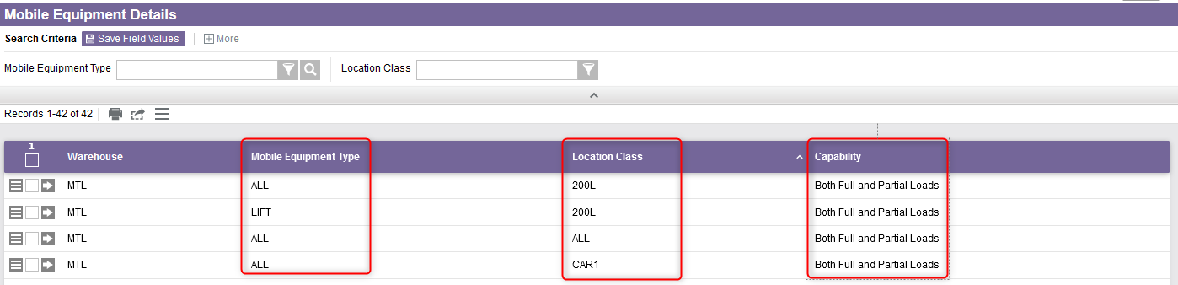
Mobile Equipment Details
The Mobile Equipment Details view will show you all mobile equipment types existing in the WMS as well as their associated locations classes.
Location class associated with the mobile equipment type which defines the location the equipment type may access. It refers to the type of storage unit.
This indicates either a full load, a partial load or both can be handled for this mobile equipment type at a specific class of location.
The type of mobile equipment a user needs to perform tasks.

Slide 77
Warehouse Searches
Back to the Table of Contents

Slide 78
Warehouse Searches
The Warehouse Searches resource is used to add, modify, copy, and delete the records in the warehouse searches table and query the records in the warehouse searches table.
Warehouse search paths are used to select inventory that matches line items in outbound orders, or to select inventory to be used in replenishment commands.
A set of rules can be assigned to a single warehouse search path. Each rule is assigned a priority, indicating the sequence in which the rule is to be examined. The search will attempt to locate inventory one rule at a time in the section specified by the rule and with the search method specified.

Slide 79
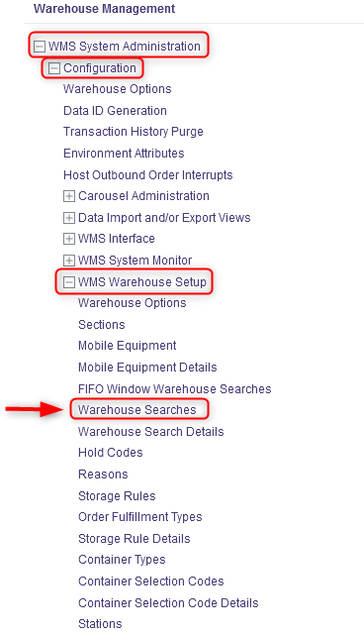
Warehouse Searches
With a desktop computer, select the WMS System Administration resource.
Under WMS System Administration, click on Configuration.
Under Configuration, click on WMS Warehouse Setup.
Under WMS Warehouse Setup, click on Warehouse Searches.

Slide 80
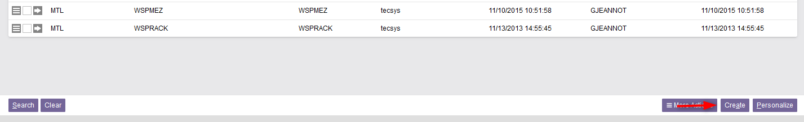
Warehouse Searches
From the new window, the different warehouse searches already configured in the WMS will be listed.
If you want to create a warehouse search path, do this:
6.1 Click on Create at the bottom right of your screen.

Slide 81
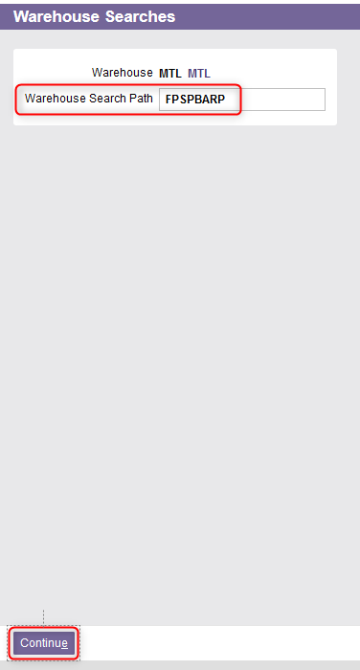
Warehouse Searches
6.2 From the new window, enter the name of the Warehouse Search Path.
6.3 Click Continue.

Slide 82
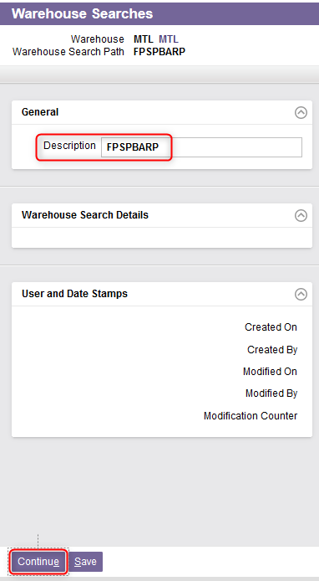
Warehouse Searches
6.4 A new window will appear. Enter a description of the warehouse search path.
6.5 Click on Continue.

Slide 83
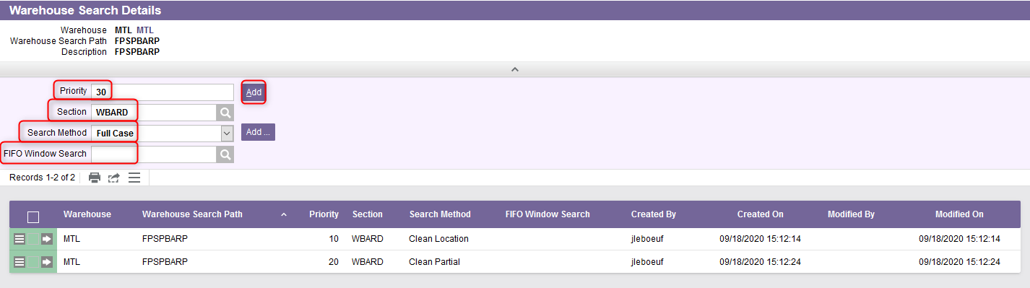
Warehouse Searches
6.6 You will be automatically redirected to the Warehouse Search Details view. Enter as many search methods as you want by:
Entering a Priority,
Entering the section,
Selecting the search method from the drop-down menu,
Adding a FIFO window search if required,
An explanation of the fields is given in the next slides.
Clicking on Add.

Slide 84
Warehouse Searches
6.6 (Continued)
Field | Explanation
Search Method | Different options are available. At a specific class of location: Clean Location indicates that the WMS will search through locations with partial loads in the specified section to clean up locations. The WMS will pick inventory from the location with the least inventory. Note that inventory from a full load may be allocated. Clean Partial indicates that the WMS will search through locations with partial loads in the specified section to clean up partial loads. The WMS will pick the partial load only if the required quantity is equal to or greater than the quantity on the partial load. The smallest partial will be picked first. Select only inventory that will empty a partial load. Full Case indicates that the WMS will search the specified section for full cases. Full Load indicates that the WMS will search the specified section for full loads. Forward Pick indicates that the WMS will search the specified section for inventory in forward pick locations. Partial indicates that the WMS will search the specified section for partial loads.

Slide 85
Warehouse Searches
6.6 (Continued)
Field | Explanation
Priority | This corresponds to the priority of the displayed entry within the search code, when the system selects inventory that matches line items in outbound orders, or to select inventory to be used in replenishment commands. Priority 1 represents the first choice for this warehouse search rule.
Section | This corresponds to the warehouse section code for the locations to search. Locations are grouped into warehouse sections for inventory selection.
FIFO Window Search | If a FIFO search is specified here, the system will execute a second search for any product that exceeds the FIFO Window field in the Items resource. The FIFO window search is only executed if some product is found as a result of the warehouse search path specified here.

Slide 86

Warehouse Searches
6.7 Once all search methods properly added, click on Submit.

Slide 87

Warehouse Searches
If you want to update a warehouse search path, do this:
7.1 Perform a search to retrieve the warehouse search path you wish to update and click on View Record Details.

Slide 88

Warehouse Searches
7.2 In the General section, update the description if need be.

Slide 89

Warehouse Searches
7.3 In the Warehouse Search Details section, the search methods already associated with the warehouse search path will be listed. You can add more if necessary:
Enter a Priority,
Enter the section,
Select the search method from the drop-down menu,
Add a FIFO window search if required,
Click on Add.

Slide 90

Warehouse Searches
7.4 Once all search methods properly added, click on Submit.

Slide 91
Warehouse Searches Details
Back to the Table of Contents

Slide 92
Warehouse Searches Details
The Warehouse Searches Details resource is used to view to add, modify, delete, and query warehouse search details.
When launched directly from the portal, this view can be used to edit existing records via Excel or the search results grid. In addition, record-level actions may be executed.
However, the Details page does not allow editing.

Slide 93

Warehouse Searches Details
With a desktop computer, select the WMS System Administration resource.
Under WMS System Administration, click on Configuration.
Under Configuration, click on WMS Warehouse Setup.
Under WMS Warehouse Setup, click on Warehouse Search Details.

Slide 94

Warehouse Searches Details
The Warehouse Searches Details view will show you all warehouse search path existing in the WMS as well as their associated search method and any relevant information.
The warehouse search path identifies the header record and is unique across all records.
Search method associated with the warehouse search path which defines how the system will week inventory within the section.
If a value is specified here, the system will execute a second search for any product that exceeds the FIFO Window field in the Items resource.
Corresponds to the priority given to the search method.
Warehouse section code for the location to search.

Slide 95
Hold Codes
Back to the Table of Contents

Slide 96
Hold Codes
The Hold Codes resource is used to add, modify, copy, delete the records in the hold codes table and to query the records in the hold codes table.
Hold codes are used to differentiate inventory and to keep separate from similar inventory, generally for the purpose of disposal, return to the vendor, testing, or inspection purposes. All inventory with a hold code will not be selected for outbound orders.
Inventory assigned a hold code will only use storage rules defined in the storage rule details table. These rules are defined for that specific hold code and will only be selected in the inventory selection algorithm for line items that request inventory with that specific hold code.

Slide 97

Hold Codes
With a desktop computer, select the WMS System Administration resource.
Under WMS System Administration, click on Configuration.
Under Configuration, click on WMS Warehouse Setup.
Under WMS Warehouse Setup, click on Hold Codes.

Slide 98

Hold Codes
In the new window, the different hold codes already configured in the WMS will be listed.
If you want to create a hold code, do this:
6.1 Click on Create at the bottom right of your screen.

Slide 99

Hold Codes
6.2 From the new window, enter the name of the hold code.
6.3 Click Continue.

Slide 100

Hold Codes
6.4 A new window will appear. Enter a description of the hold code.
6.5 Indicate Yes or No in the Affect Damaged field.
Yes indicates that the inventory is damaged and will either be disposed of or returned to the vendor. If Yes is selected, the inventory for this hold code will be deducted from the on-hand inventory in the DMS.
No indicates that the inventory is on hold and will be tested or inspected.
6.6 Click Submit.

Slide 101

Hold Codes
If you want to update a hold code, do this:
7.1 Perform a search to retrieve the hold code you wish to update and click
on View Record Details.

Slide 102

Hold Codes
7.2 In the General section, if necessary:
Update the description,
Update the Affect Damaged field. Refer to the slide 100 for more details regarding this field.
7.3 Once all the required fields properly updated, click on Submit.

Slide 103
Reasons
Back to the Table of Contents

Slide 104
Reasons
The Reasons resource is used to add, modify, copy, delete the records in the reasons table and to query the records in the reasons table.
Reason codes are standardized explanations of various actions a user may perform.
Reason codes are required in performing any inventory adjustment via either the Inventory Adjustments, Inventory Status Modification, or Inventory Relocation resources and may be used during the receiving process.

Slide 105

Reasons
With a desktop computer, select the WMS System Administration resource.
Under WMS System Administration, click on Configuration.
Under Configuration, click on WMS Warehouse Setup.
Under WMS Warehouse Setup, click on Reasons.

Slide 106

Reasons
From the new window, the existing reasons code already configured in the WMS will be listed.
If you want to create a reason code, do this:
6.1 Click on Create at the bottom right of your screen.

Slide 107

Reasons
6.2 From the new window, enter the name of the reason code.
6.3 Click Continue.

Slide 108

Reasons
6.4 A new window will appear. Enter a description of the reason code.
6.5 Click Submit.

Slide 109

Reasons
If you want to update a reason code, do this:
7.1 Perform a search to retrieve the reason code you wish to update and click
on View Record Details.

Slide 110

Reasons
7.2 In the General section, update the description of the reason if necessary.
7.3 Once the description field properly modified, click Submit.

Slide 111
Storage Rules
Back to the Table of Contents

Slide 112
Storage Rules
The Storage Rules resource is used to add, modify, copy, delete the records in the storage rules table and to query the records in the storage rules table.
Storage rules specify how the system stores received inventory into a storage location.
Storage rules are also used to find storage locations during inventory moves.
Note that the items received with an assigned hold code defined in the Hold Codes resource will not use any part of the storage rule that does not specify that hold code.

Slide 113

Storage Rules
With a desktop computer, select the WMS System Administration resource.
Under WMS System Administration, click on Configuration.
Under Configuration, click on WMS Warehouse Setup.
Under WMS Warehouse Setup, click on Storage Rules.

Slide 114

Storage Rules
From the new window, the different storage rules already configured in the WMS will be listed.
If you want to create a new storage rule, do this:
6.1 Click on Create at the bottom right of your screen.

Slide 115

Storage Rules
6.2 A new window will appear. Enter the name of the storage rule.
6.3 Click Continue.

Slide 116

Storage Rules
6.4 A new window will appear. Enter a description for the storage rule.
6.5 Click Continue.

Slide 117

Storage Rules
6.6 You will be automatically redirected to the Storage Rule Details view. Enter as many rules as you want by entering/selecting :
A consolidation rule,
A zone,
A search rule,
A quantity rule,
A hold code (if applicable)
A priority
An explanation of the fields is given in the next slides.
Then click on Add.

Slide 118
Storage Rules
6.6 (Continued)
Field | Explanation
Storage Rule | The unique storage rule identifier for the record. Each rule may consist of several entries, which are evaluated in order of priority.
Consolidation Rule | Different options are available: Always Consolidate with Same Item indicates that the location to be selected through the storage rule must already contain a product of the same item. The location's capacity and dimensions will be ignored and the inventory will be forced to that location. Consolidate with Same Item indicates that the location to be selected through the storage rule must already contain product of the same item. Find Empty Locations indicates that the location to be selected through the storage rule is currently empty. Mix with Other Items indicates that the location to be selected through the storage rule is not empty and may contain product of a different item.

Slide 119
Storage Rules
6.6 (Continued)
Field | Explanation
Search Rule | Different options are available: By Storage Sequence indicates that the search should be in order of the location's storage sequence. By Capacity indicates that the search should be in order of the location's cube capacity, and then in order of the location's storage sequence. This field is maintainable when the Consolidation Rule is set to Find Empty Locations. Otherwise, the default value is set to By Storage Sequence and it is not maintainable.
Zone | The zone used to select a location in which the inventory is to be stored. The system will examine locations in that zone in order of store sequence.
Priority | The priority of this record within the storage rule. Each record in a storage rule is evaluated in order of priority, from lowest to highest.
Hold Code | The hold code of a full or partial load. This is used to provide a means to identify inventory that is to be kept separate from similar inventory.

Slide 120
Storage Rules
6.6 (Continued)
Field | Explanation
Quantity Rule | Different options are available: Use Individual Receipt Quantity indicates that the individual receipt quantity should be used in all of the storage logic calculations. This assumes that the full quantity received for a receipt is normally totaled and recorded in a single entry and/or that the inbound order line expected quantities are not always completely filled within a single receipt. Use Total Expected Quantity indicates that the item's total expected receipt quantity should be used in all of the storage logic calculations. The total expected receipt quantity is calculated as the total quantity ordered minus total completed quantity of all inbound order lines in the receipt for the item to be stored.

Slide 121

Storage Rules
6.7 Once all consolidation rules properly added, click on Submit.

Slide 122

Storage Rules
If you want to update a storage rule, do this:
7.1 Perform a search to retrieve the storage rule you wish to update and click on View Record Details.

Slide 123

Storage Rules
7.2 In the General section, update the description if need be.

Slide 124

Storage Rules
7.3 In the Storage Rule Details section, the consolidation rules already associated with the storage rule will be listed. You can add more if necessary:
Select a consolidation rule,
Enter a zone,
Select a search rule,
Select a quantity rule
Enter a hold code (if applicable)
Enter the priority
Then click on Add.

Slide 125

Storage Rules
7.4 Once all consolidation rules properly added, click on Submit.

Slide 126
Storage Rules Details
Back to the Table of Contents

Slide 127
Storage Rules Details
This resource is used to add, modify, delete the records in the storage rule details table and to query the records in the storage rule details table.
When launched directly from the portal, this view can be used to edit existing records via Excel or the search results grid. In addition, record-level actions may be executed.
However, the Details page does not allow editing.

Slide 128

Storage Rules Details
With a desktop computer, select the WMS System Administration resource.
Under WMS System Administration, click on Configuration.
Under Configuration, click on WMS Warehouse Setup.
Under WMS Warehouse Setup, click on Storage Rules Details.

Slide 129

Storage Rules Details
The Storage Rules Details view will show you all storage rules existing in the WMS along with their associated parameters.
The zone used to select a location in which the inventory is to be stored.
Name of the storage rule
The consolidation rule chosen among the different options available. While evaluating locations in a given zone, the system will only consider locations that match the consolidation rule.
The priority of the record within the storage rule.

Slide 130

Storage Rules Details
(Continued)
The quantity rule chosen among the different options available which is either the individual receipt quantity or the total expected quantity.
Field used to provide a means to identify inventory that is to be kept separate from similar inventory (e.g., for disposal, return to the vendor, testing, inspection purposes).
The search rule chosen among the different options available which is either in order of the location's storage sequence or in order of the location's cube capacity, and then in order of the location's storage sequence.

Slide 131
Container Types
Back to the Table of Contents

Slide 132
Container Types
The Container Types resource is used to add, modify, copy, and delete the records in the container types table and to query the records in the container types table.
Containers serve to group inventory together and are used to either move product from one location to another or to track multiple inventory tags as a single entity. Containers may be created in the process of storing, picking, replenishing or packing. The container is specified when product is being stored, picked or replenished into a container.
The type of container is typically a box, tote, pallet or any vehicle used to consolidate merchandise for inventory transfer or storage purposes.

Slide 133
Container Types
Container types define whether a given container is permanent or not:
Permanent containers will retain the name and attributes defined upon creation of the container, unless the container is delivered to an exit location or is shipped completed (e.g., a permanent container used to store product will be tracked after the store is completed).
Temporary containers will disappear from the system when the function for which the container is being used is completed (e.g., when a temporary container is used to store product, the container will no longer be tracked by the system.
Containers are also defined as being transport or non-transport containers:
Transport containers are used in the process of moving product from one location to another within a given section (e.g., Totes and pallets used to move inventory from a receiving dock to storage locations or from storage locations to packing stations)
Non-transport containers are used to track multiple tags as a single unit, for the purpose of storage and shipping. Non-transport containers may actually leave the building and be shipped to a customer.

Slide 134

Container Types
With a desktop computer, select the WMS System Administration resource.
Under WMS System Administration, click on Configuration.
Under Configuration, click on WMS Warehouse Setup.
Under WMS Warehouse Setup, click on Container Types.

Slide 135

Container Types
In the new window, the different container types already configured in the WMS will be listed.
If you want to create a container type, do this:
6.1 Click on Create at the bottom right of your screen.

Slide 136

Container Types
6.2 From the new window, enter the name of the container type.
6.3 Click Continue.

Slide 137

Container Types
6.4 A new window will appear. Complete the General section for the fields shown below.
An explanation of the fields is given in the next slides.

Slide 138
Container Types
6.4 . (Continued)
Field | Explanation
Description | Description of the container type.
Transport | Yes indicates that this is a transport container. Transport containers only contain inventory to be moved within the section. They are never used to store product or to ship product to a customer. No indicates that this is a non-transport container. A non-transport container is used for the purposes of storage and/or shipping.
Permanent | Yes indicates that this is a permanent container. Permanent containers exist as containers even if there is no inventory within them. In this case, the system retains the container license number because the container needs to be reused within the section No indicates that this is a temporary container. Temporary containers are deleted once they are emptied.
Is Shippable Container | Yes indicates that the container type can be used for shipping purposes. When the container is defined as a transport container, it cannot be nested into another container. No indicates that the container type cannot be used for shipping purposes, but can be nested or merged into other containers.

Slide 139
Container Types
6.4 . (Continued)
Field | Explanation
Minimum Fill Percent | The minimum volume of product that merit the container.
Maximum Fill Percent | The maximum usable volume for the container.
Maximum Weight Capacity | The maximum weight that the container can carry.
Interior Depth/Height/Width | The internal depth/height/width of a container.
External Depth/Height/Width | The external depth/height/width of a container. Additional Note – External Height When Add Dimensions is set to No, the external height must be the actual height of the closed container or the estimated full capacity height of the pallet (i.e. including the estimated height of inventory placed on the pallet). When Add Dimensions is set to Yes, the external height must be the actual height of the empty pallet.

Slide 140
Container Types
6.4 . (Continued)
Field | Explanation
Empty Container Weight | This is the weight of the empty container. This field is used when the weight of the empty container is deducted from the total order weight for order verification purposes.
Empty Container Weight for Conveyor | This is the weight of the empty container. This field is used when the weight of the empty container is deducted from the total weight of the order, intended for the conveyor, and for order verification purposes.
Allow Cross Docking | Yes indicates that cross docks are to be filled with this type of container. This field, when used in conjunction with the Areas resource, allows cross docking. No indicates that this type of container will not be used in cross dock opportunities.
Add Dimensions | Yes indicates that the total volume consists of the container volume, calculated using the external dimensions, plus the volume calculated from the quantity and dimensions of each tag and container that make up the container's contents. The overall dimensions consist of the External Width and External Depth and an estimated height, calculated as the total volume divided by the External Width and External Depth. No indicates that the overall dimensions will consist of the container's external dimensions.

Slide 141
Container Types
6.4 . (Continued)
Field | Explanation
Single Piece Container | Yes indicates that this container is considered to be only one piece if nested in a non-transport container. No indicates that the container may represent several pieces if nested.
Location Size | This field is optional and matched to the Size field in the location when the system searches for a suitable storage location. When this field is left blank, the system will perform volumetric calculations to determine if the container will fit into a location. When this field is assigned a value other than blank, the system will assume that the container is a single load to determine if it will fit into a location.
EDI Packaging Type | Choose the appropriate option based on your container type from the drop-down menu. This value is used to identify the packaging type of EDI shipping containers. Used for the UCC128 bar code number creation. This value represents the third character prefix of the UCC128.

Slide 142

Container Type
6.5 Once all the required fields in the General section have been completed, click Submit.
6.6 Click Close to exit the Container Type resource.

Slide 143

Container Type
If you want to update a container type, do this:
7.1 Perform a search to retrieve the container type you wish to update and click on View Record Details.

Slide 144

Container Type
7.2 In the General section, update the description if need be. An explanation of the fields is given in slides 138 to 141.

Slide 145

Container Type
7.3 Once all the required fields properly updated, click on Submit.

Slide 146
Container Selection Codes
Back to the Table of Contents

Slide 147
Container Selection Codes
The Container Selection Codes is used to add, modify, copy, and delete the records in the container selection code table and to query the records in the container selection code table.
While picking, the user will be directed to pick into a container. The container is specified by the system, based on volumetric calculations.
Each container type is checked for the dimensions of the container type, the maximum weight capacity allowed, the minimum fill percentage, and the maximum fill percentage of the container. The dimensions and weight of the product to be picked in the area for the shipment or order are checked against the dimensions, weight, fill percentages, and rotation within the container.

Slide 148

Container Selection Codes
With a desktop computer, select the WMS System Administration resource.
Under WMS System Administration, click on Configuration.
Under Configuration, click on WMS Warehouse Setup.
Under WMS Warehouse Setup, click on Container Selection Codes.

Slide 149

Container Selection Codes
In the new window, the container selection codes already configured in the WMS will be listed.
If you want to create a container selection code, do this:
6.1 Click on Create at the bottom right of your screen.

Slide 150

Container Selection Codes
6.2 From the new window, enter the name of the Container selection code.
The container selection code identifies the header record and is unique across all records.
6.3 Click Continue.

Slide 151

Container Selection Codes
6.4 A new window will appear. Enter a description of the container selection code.
6.5 Click on Continue.

Slide 152

Container Selection Codes
6.6 You will be automatically redirected to the Container Selection Code Details view. Enter as many selection sequences as you want by:
Entering the Selection Sequence,
Selecting a Container Type,
Clicking on Add.
An explanation of the fields is given in the next slide.

Slide 153
Container Selection Codes
6.6 (Continued)
Field | Explanation
Selection Sequence | The sequence in which the specified container type is to be considered. It is recommended that this number be entered in increments of 10 when creating the initial container selection list. This allows for the subsequent addition of entries in between the original sequences.
Container Type | The container type for the specified sequence in the specified code

Slide 154

Container Selection Codes
6.7 Once all selection sequences are properly added, click on Submit.

Slide 155

Container Selection Codes
If you want to update a container selection code, do this:
7.1 Perform a search to retrieve the container selection code you wish to update and click on View Record Details.

Slide 156

Container Selection Codes
7.2 In the General section, update the description if need be.

Slide 157

Container Selection Codes
7.3 In the Container Selection Code Details section, the selection sequences already associated with the container selection code will be listed. You can add more if necessary:
Enter the Selection Sequence,
Enter the Container Type,
Click on Add.
For more details on these two fields, refer to slide 153.

Slide 158

Container Selection Codes
7.4 Once all the required fields properly updated, click on Submit.

Slide 159
Container Selection Code Details
Back to the Table of Contents

Slide 160
Container Selection Code Details
This resource is used to add, modify, and delete the records in the container selection code details table and to query the records in the container selection code details table.
When launched directly from the portal, this view can be used to edit existing records via Excel or the search results grid. In addition, record-level actions may be executed.
However, the Details page does not allow editing.

Slide 161

Container Selection Code Details
With a desktop computer, select the WMS System Administration resource.
Under WMS System Administration, click on Configuration.
Under Configuration, click on WMS Warehouse Setup.
Under WMS Warehouse Setup, click on Container Selection Code Details.

Slide 162

Container Selection Code Details
The Container Selection Code Details view will show you all container selection codes existing in the WMS as well as their associated selection sequences and any relevant information.
Identifies the header record and is unique across all records.
Description of the container selection code.
The sequence in which the specified container type is to be considered.
This specifies the container type for the specified sequence.
Description of the Container Type

Slide 163
Stations
Back to the Table of Contents

Slide 164
Stations
This resource is used to add, modify, copy, and delete the records in the stations table and to query the records in the stations table.
The station is generally a central point in the facility where a supervisor works or where the printing equipment is located. Typically, this is an office where users report at the start of each day to pick up their mobile computers. When signing on to the system, a user must state the station from which he/she is working.
Many default operating parameters are established at the station level such that if distinctly different operational activities or physical barriers exist in a given facility, it is likely that multiple stations will be required.
Moreover, if multiple buildings are being operated, each building should have its own station.

Slide 165

Stations
With a desktop computer, select the WMS System Administration resource.
Under WMS System Administration, click on Configuration.
Under Configuration, click on WMS Warehouse Setup.
Under WMS Warehouse Setup, click on Stations.

Slide 166

Stations
In the new window, the different stations are already configured in the WMS will be listed.
If you want to create a station, do this:
6.1 Click on Create at the bottom right of your screen.

Slide 167

Stations
6.2 From the new window, enter the name of the station.
6.3 Click Continue.

Slide 168



Stations
6.4 From the new window, three sections will appear: General, Printers, Container Types.

Slide 169

Stations
6.5 Complete the General section for the fields shown below. An explanation of the fields is given in the next slide.

Slide 170
Stations
6.5 (Continued)
Field | Explanation
Default Receiving Location | This is the default receiving location for users logged onto the station. When a user performs basic or inbound receipts, this will appear as the default receiving location on the user's screen.
Default Warehouse Search Path | This is the default warehouse search path for the user station. When a user performs a demand pick or creates outbound order details, this will appear as the default warehouse search path. The warehouse search path must be predefined in the warehouse searches table beforehand.
Measurement Device Name | The field corresponds to the measurement device name.

Slide 171

Stations
6.6 Complete the Printers section for the fields shown below. An explanation of the fields is given in the next slide.

Slide 172
Stations
6.6 (Continued)
Field | Explanation
Report Printer | The printer queue name of the report printer. This is used to print all printed reports other than transaction lists (e.g. putaway list) and shipping paperwork.
List Printer | The printer queue name of the list printer. This is used for putaway lists, replenishment lists, and cycle count lists.
Pick List Printer | The printer queue name of the pick list printer. This is used to print pick lists from a desktop computer.
Container Packing List Printer | The printer queue name of the container packing list printer. This is used to print the container packing lists.
Master Packing List Printer | The printer queue name of the master packing list printer. This is used to print master packing lists.
Bill of Lading Printer | The printer queue name of the printer at which bills of lading will be printed for users logged on to this station.
Manifest Printer | The printer queue name of the manifest printer for users logged onto this station. This is used to print carrier manifests.

Slide 173

Stations
6.7 Complete the Container Types section for the fields shown below. An explanation of the fields is given in the next slide.

Slide 174
Stations
6.7 (Continued)
Field | Explanation
Default Container Type | The default container type when no build container is specified. When a user performs the Container Build function, this will be the default container type for any new build container specified. Typically, this is a container used at a packing station.
Default Transport Container Type | The default container type used for transportation.
Default Container Type for Receiving | The default receiving container type when no receiving container is specified.
Default Container Type for Replenishment | The default replenish container type when no replenishment container is specified. Typically, this is a container used for replenishment of forward pick locations.
Default Container Type for Stores | The default storage container type when no storage container is specified.

Slide 175
Stations
6.7 (Continued)
Field | Explanation
Default Container Type for Pick | The default pick container type when no pick container is specified. Typically, this is a container used for picking outbound product.
Default Container Type for Nesting | The default container type to be used for nesting, when no other such container is specified. When the user does not specify an existing container to be nested into (or onto), the system generates a new container number and assigns the Default Container Type for Nesting to the new container. Typically, this is a container used at a packing station.
Default Container Type for Merge | The default merge container type when no merge container is specified. When a user executes the Container Merge resource on a mobile computer, this will be the default container type for any new merge container specified. Typically, this is a container used at a packing station.

Slide 176

Stations
6.8 Once all the required fields in the sections have been completed, click Submit.
6.9 Click Close to exit the Station resource.

Slide 177

Stations
If you want to update a station, do this:
7.1 Perform a search to retrieve the station you wish to update and click on View Record Details.

Slide 178



Stations
7.2 From the new window, update the required fields in the General, Printers, and Container Types sections. For more details on the different fields, refer to slides 170 to 175.

Slide 179

Stations
7.3 Once all the required fields properly updated, click on Submit.

Slide 180
Stations Devices
Back to the Table of Contents

Slide 181
Stations Devices
This resource is used to add, modify, copy, and delete the records in the station devices table and to query the records in the station devices table.
A station device record is used to link a given station to a given document format and document type.
When a user logs into a station, any label output created by that user will be directed to the associated device. Moreover, each user is assigned a default station in the WMS Users resource.

Slide 182

Station Devices
With a desktop computer, select the WMS System Administration resource.
Under WMS System Administration, click on Configuration.
Under Configuration, click on WMS Warehouse Setup.
Under WMS Warehouse Setup, click on Station Devices.

Slide 183

Stations Devices
In the new window, the different stations already linked to a given document format and type in the WMS will be listed.
If you want to create a new station device record, do this:
6.1 Click on Create at the bottom right of your screen.

Slide 184

Stations Devices
6.2 From the new window, select the Station as well as the Document Format Name and the Document Type (from the drop-down menu) to be linked to the given station.
Note: The Document Format Name is the unique identifier for this document format definition.
6.3 Click Continue.

Slide 185

Stations Devices
6.4 A new window will appear. In the General section, select the Device to be used.
The device is used by printing resources to select the output destination.
6.5 Click on Submit.

Slide 186

Stations Devices
If you want to update a station device record, do this:
7.1 Perform a search to retrieve the station device record you wish to update and click on View Record Details.

Slide 187

Stations Devices
7.2 You only have the option to change the Device in the General section if needed.
7.3 Once done, click on Submit.

Slide 188

Stations Devices
Additional Note – If you want to update the Document Format Name and the Document Type of a given station device, you need first delete the desired station device record and then recreate it:
Retrieve the station device record and delete it:
Then follow the same steps 6.1 to 6.5 as explained previously to recreate a station device by modifying the Document Format Name and the Document Type as required.

Slide 189
Areas
Back to the Table of Contents

Slide 190
Areas
This resource is used to add, modify, copy, and delete the records in the areas table and to query the records in the areas table.
Areas are used to group locations for the management and organization of labor and the assignment of work to users (i.e., task management). Each location (defined in the locations table) is therefore a member of one area.
Areas tend to be defined based on distinctly different sections of the warehouse where an inventory handling system requires a dedicated workforce or the mobile equipment requirements are different.

Slide 191


Areas
With a desktop computer, select the WMS System Administration resource.
Under WMS System Administration, click on Configuration.
Under Configuration, click on WMS Warehouse Setup.
Under WMS Warehouse Setup, click on Areas.

Slide 192

Areas
In the new window, the different areas and related information that are already configured in the WMS will be listed.
If you want to create a new area, do this:
6.1 Click on Create at the bottom right of your screen.

Slide 193

Areas
6.2 From the new window, enter the name of the area.
6.3 Click Continue.

Slide 194


Areas
6.4 From the new window, five sections will appear: General, Putaway, Replenishments, Picking and Cycle Count.

Slide 195

Areas
6.5 Complete the General section for the fields shown below. An explanation of the fields is given in the next slides.

Slide 196
Areas
6.5 (Continued)
Field | Explanation
Equipment Used for Picks | Choose the appropriate option in the drop-down menu: Conventional indicates that area picking is done with commands issued from a desktop computer. Label-Directed Cluster Picking indicates that area picking is done in label-directed cluster picking mode. Mechanical (AS and RS) indicates that area picking is done in mechanical mode. RF indicates that area picking is done with commands issued from a mobile computer. System-Directed Cluster Picking indicates that area picking is done in system-directed cluster picking mode.

Slide 197
Areas
6.5 (Continued)
Field | Explanation
Equipment Used for Replenishments | In the same way as for Equipment Used for Picks, choose the appropriate option in the drop-down menu: either Conventional, Mechanical (AS and RS) or RF to perform replenishments.
Equipment Used for Stores | In the same way as for Equipment Used for Picks, choose the appropriate option in the drop-down menu: either Conventional, Mechanical (AS and RS) or RF to perform storage.
Equipment Used for Cycle Counts | In the same way as for Equipment Used for Picks, choose the appropriate option in the drop-down menu: either Conventional, Mechanical (AS and RS) or RF to perform cycle counts.
Allow Cross Docking | Yes indicates that cross docks are to be filled from this area. No indicates that cross docks are not to be filled from this area.

Slide 198

Areas
6.6 Complete the Putaway section for the following fields:
Storage Age: This represents the length of time the system will allow commands to exist in the system before increasing the priority of those commands.
Store Command Label Required: Indicate Yes if you want a label to be printed when processing the putaway command from the printer associated with the station in which the user is currently logged. Otherwise, select No. Note that conventional commands will not generate a label (only with mobile or mechanized interface).

Slide 199

Areas
6.7 Complete the Replenishments section for the following fields:
Replenishment Age: This represents the length of time the system will allow commands to exist in the system before increasing the priority of those commands.
Replenishment Command Label Required: Indicate Yes if you want a label to be printed when processing the replenishment command from the printer associated with the station in which the user is currently logged. Otherwise, select No. Note that conventional commands will not generate a label (only with mobile or mechanized interface).

Slide 200

Areas
6.8 Complete the Picking section for the fields shown below. An explanation of the fields is given in the next slides.

Slide 201
Areas
6.8 (Continued)
Field | Explanation
Container Selection Code | The container selection code specifies the sequence of container types the system will test when picking into a container.
Container Selection Code Station | The name of the station where the printer to be used to print container labels is located, if a container selection code is specified.
Automatically Assign To Container | Select Yes or No to indicate whether or not a To Container will be automatically generated and assigned for a pick command. A container will be assigned where one was not already assigned by CPRE logic or any other logic. Note that this is not applicable to conventional type commands.
Pick Command Label Required | Select Yes or No to indicate whether or not the label with pick command details should be printed when presenting a pick command. Note that this is not applicable to conventional type commands.
Pick by Label | Select Yes if you wish to enable the generation of pick labels for this area. Otherwise, select No. If you selected Yes: In this case, the Pick Label Printer Station field must not be blank. Also, the Equipment Used for Picks field cannot be set to Label-Directed Cluster Picking System-Directed Cluster Picking.

Slide 202
Areas
6.8 (Continued)
Field | Explanation
Full Case | This field is only maintainable when the Pick by Label option is set to Yes. No indicates that both full case and less than a case quantities will be considered for pick label generation. Yes indicates that only full case quantities will be considered for pick label generation. The full case is determined by the pick label UOM value set up in the item for the item being processed.
Pick Label Printer Station | The printer to be used to print pick labels specified by the system, if the Pick by Label field is set to Yes.
Main Pick Consolidation Location | This is the main pick consolidation location for a pick consolidation area. This field is used as the next destination in the pick routing process, when dealing with routed picks to a pick consolidation area.This location must be of the PACK type and can only be populated in the area code associated with the location record for the location area.

Slide 203
Areas
6.8 (Continued)
Field | Explanation
Pick Consolidation Area | The pick consolidation area to where the pick commands associated with the current area will be directed for shipment container consolidation. An area is considered a pick consolidation area if the Main Pick Consolidation Location field is populated.
Pick Age | This represents the length of time the system will allow commands to exist in the system before increasing the priority of those commands.
Serial Number at Pick Time | Allow indicates that the user may assign serial numbers to product during picking, but is not required to. Force indicates that the user is required to capture serial numbers during picking. Skip indicates that the user is not allowed to assign serial numbers to product during picking.

Slide 204

Areas
6.9 Complete the Cycle Count section for the fields shown below. An explanation of the fields is given in the next slide.

Slide 205
Areas
6.9 (Continued)
Field | Explanation
Cycle Count Frequency | This represents the number of days between automatically scheduled cycle counts for all locations in a given area. If a cycle count has not been generated for locations in this area within the specified number of days, the system will automatically generate cycle counts for those locations. In the Warehouse Options resource, The Automatic Cycle Count flag enables you to switch this feature on or off.
Minimum Cycle Count Trigger Frequency | This is the minimum number of days allowed between generated trigger-level cycle counts for all locations in the area. This value limits the number of triggered cycle counts that may occur over a period of days. To turn off this feature, set to -1.
Require Approval for Cycle Count Exception | Select Yes or No to indicate whether or not the mobile cycle count exceptions must be approved before the variance is applied to the inventory quantity.
Cycle Count Age | This represents the length of time the system will allow commands to exist in the system before increasing the priority of those commands.

Slide 206

Areas
6.10 Once all the required fields in the sections have been completed, click Submit.
6.11 Click Close to exit the Areas resource.

Slide 207

Areas
If you want to update an area, do this:
7.1 Perform a search to retrieve the area you wish to update and click on View Record Details.

Slide 208

Areas
7.2 From the new window, update the required fields in the General, Putaway, Replenishments, Picking and Cycle Count sections. For more details on the different fields, refer to slides 195 to 205.

Slide 209

Areas
7.3 In the Area Confirmations section, you can also update the confirmation flags of the different task codes associated with this area. Note that you also have the option to perform this step through the Area Confirmations resource explained further in this document.
7.3.1 To update the confirmation flags directly from this section, select the desired record and click on View Record Details.

Slide 210

Areas
7.3.2 Modify the displayed fields if necessary and click on Continue once done.
An explanation of these fields is given in slides 216 to 219.

Slide 211

Areas
7.4 Once all the required fields in sections properly updated, click on Submit.

Slide 212
Area Confirmations
Back to the Table of Contents

Slide 213
Area Confirmations
This resource is used to add, modify, delete the records in the area confirmations table and to query the records in the area confirmations table.
The task codes shown in this resource are only populated once the area setup has been saved through the Area resource.
Once saved, the user can then modify the confirmation flags in the area confirmations table accessible via this resource.

Slide 214

Area Confirmations
To update the confirmation flags in one of the areas:
With a desktop computer, select the WMS System Administration resource.
Under WMS System Administration, click on Configuration.
Under Configuration, click on WMS Warehouse Setup.
Under WMS Warehouse Setup, click on Area Confirmations.

Slide 215

Area Confirmations
In the new window, the different task codes associated with the areas previously configured in the Area resource will be listed.
Perform a search to retrieve the record you wish to update and click on View Record Details. The search can be a combination of Area, Task code and Task Type.

Slide 216

Area Confirmations
A new window will appear from which you can update eight fields:
Location Confirmation Option: This flag confirms the accurate location selection at pickup time, regardless of whether the data is scanned or manually entered via the Location Confirmation on a mobile computer. Note that normally this option is used for voice only but can be activated for mobile picking and mobile replenishment ; it just adds another validation step for the user to the process the task.

Slide 217

Area Confirmations
Pickup Confirmation by Location: Select Yes or No to indicate whether or not you wish to enable a pickup confirmation by location for this area.
Pickup Confirmation by Item: Select Yes or No to indicate whether or not you wish to enable a pickup confirmation by item for this area.
Pickup Confirmation by Container: Select Yes or No to indicate whether or not you wish to enable a pickup confirmation by container for this area.

Slide 218

Area Confirmations
Pickup Confirmation by Tag: Select Yes or No to indicate whether or not you wish to enable a pickup confirmation by tag for this area.
Pickup Confirmation by Check Digit: Select Yes or No to indicate whether or not you wish to enable a pickup confirmation by check digit for this area. In this case, the check digit must be specified in the locations table.
Require To-Container Confirmation: Select Yes or No to indicate whether or not the user is required to enter the To Container in the Confirm To Container field at the pick completion step.

Slide 219

Area Confirmations
Drop-off Confirmation Option: This flag confirms the accurate drop-off of a product at a location, regardless of whether the data is scanned or entered manually via the Confirm Drop-off Command view on a mobile computer.

Slide 220

Area Confirmations
Once all the required fields properly updated, click on Submit.

Slide 221
WMS Users
Back to the Table of Contents

Slide 222
WMS Users
The WMS Users resource is used to add, modify, and delete the records in the WMS users table, to copy a single user's profile to a new user and to query the records in the WMS users table.
Refer to the "WMS Tecsys_System Administration_ WMS User Management" document for more details regarding this resource.

Slide 223
Document Format Definitions for WMS
Back to the Table of Contents

Slide 224
Document Format Definitions for WMS
This resource is used to add, modify, copy, and delete the records in the document format definitions for WMS table and to query the records in the document format definitions for WMS table.
The Document Format Definitions for WMS resource is used to identify the document formats that require TMS shipments to be created. Document format definitions are used to group document types together. Grouping is usually based on content (i.e., label and view customization).
Example: A XYZ customer has requested that certain application-specific labels be customized for their own exclusive use. In this case, you would create a document format definition named ABC_xyz that would be used to group all of XYZ's customized labels and views associated with application ABC.

Slide 225

Document Format Definitions for WMS
With a desktop computer, select the WMS System Administration resource.
Under WMS System Administration, click on Configuration.
Under Configuration, click on WMS Warehouse Setup.
Under WMS Warehouse Setup, click on Document Format Definitions for WMS.

Slide 226
Document Format Definitions for WMS
In the new window, the different document formats already configured in the WMS for the TMS shipments will be listed.
If you want to create a new one, do this:
6.1 Click on Create at the bottom right of your screen.

Slide 227

Document Format Definitions for WMS
6.2 From the new window, enter the name of the document format.
This is the unique identifier for this document format.
6.3 Click Continue.

Slide 228

Document Format Definitions for WMS
6.4 A new window will appear.
In the TMS Shipment Required field, select Yes or No to indicate whether a TMS shipment is required or not.

Slide 229

Document Format Definitions for WMS
6.5 In the Default Carrier Document Format field, select Yes or No to indicate if the document format is the default carrier compliant label format used when printing the label or not.
This field is only applicable to TMS-enabled parcel carriers.
The field is not accessible when no carrier services are TMS-enabled.

Slide 230

Document Format Definitions for WMS
6.6 In the Number of Lines per Label field, indicate the number of comment lines, either header or detail comment, to include on a pick command comment label. This label is an option as an appended print output for the pick command label. The printed comments are retrieved from the outbound order header and detail comment fields.
If the field is set to 0, the pick command comment label will not print.
If the field is set to a value greater than 0, then this will be the maximum number of lines to print on a pick command comment label before appending additional comments to one or more labels.
6.7 Click on Submit.

Slide 231

Document Format Definitions for WMS
If you want to update a document format, do this:
7.1 Perform a search to retrieve the document format you wish to update and click on View Record Details.

Slide 232

Document Format Definitions for WMS
7.2 Update the three following fields as explained in slides 228 to 230.
7.3 Once the fields have been updated, click on Submit.

Slide 233
Route Points
Back to the Table of Contents

Slide 234
Route Points
The Route Points resource is used to add, modify, copy, delete the records in the route points table and to query the records in the route points table.
A route point is used to identify a starting point, an intermediate step, or a destination point in a route.
A route is used to convert a simple warehouse product movement task into a series of steps that potentially requires the involvement of multiple users.
Once the route points are created, the routes are then defined via the Route Work resource.

Slide 235

Route Points
With a desktop computer, select the WMS System Administration resource.
Under WMS System Administration, click on Configuration.
Under Configuration, click on WMS Warehouse Setup.
Under WMS Warehouse Setup, click on Route Points.

Slide 236
Route Points
In the new window, the different route points already configured in the WMS will be listed.
If you want to create a route point, do this:
6.1 Click on Create at the bottom right of your screen.

Slide 237

Route Points
6.2 From the new window, enter the name of the route point.
6.3 Click Continue.

Slide 238

Route Points
6.4 A new window will appear. Enter a description of the route point in the Description 1 field as well as in the Description 2 field if needed.
6.5 Click on Submit.
The route point has been created.

Slide 239

Route Points
If you want to update a route point, do this:
7.1 Perform a search to retrieve the mobile equipment you wish to update and click on View Record Details.

Slide 240

Route Points
7.2 A new window will appear. Update the description of the route point in the Description 1 field as well as in the Description 2 field if needed.
7.3 Click on Submit.
The route point has been updated.

Slide 241
Route Work
Back to the Table of Contents

Slide 242
Route Work
The Route Work resource is used to add and delete the records in the route work table and to query the records in the route work table. Essentially, the routes are defined via this resource.
Routes direct multiple users to handle the same product as it travels through the warehouse to complete putaway, replenishment, or pick commands in an environment using mobile computers.
A route, with specified route points, can be used to direct a user to move product part of the distance, and direct a second user to move the product the rest of the way.
Routes are also used to segment a series of tasks.
Example: Picked product may be deposited at a packing station for processing and then moved to a staging location for shipping. A route can be set up to issue a command to a user to move the picked product to the packing station, and then to issue a second command to a different user to move the (now packed) product to the staging location.

Slide 243
Route Work
Routes are specified as a series of route points and are tied together by a destination route point:
A route point associated with the starting point of a route is assigned to the location or group of locations that identify the starting point. Example: The starting route point for a replenishment route might be assigned to a location of type BULK (“Bulk Storage”).
A route point associated with the intermediate step of a route must be assigned to a location or group of locations of type INTR (“In Transit”) so that the location(s) can be used specifically for the temporary storage of product when moving the product along the route.
A route point associated with the destination point of a route is assigned to the location or group of locations that are the ultimate destination(s) of warehouse product movement tasks. Example : The destination route point for a replenishment route might be assigned to a location of type FP (“Forward Pick”).

Slide 244

Route Work
To create a route in the warehouse:
With a desktop computer, select the WMS System Administration resource.
Under WMS System Administration, click on Configuration.
Under Configuration, click on WMS Warehouse Setup.
Under WMS Warehouse Setup, click on Route Work.

Slide 245

Route Work
From the new window, enter the First Route Point as well as the Destination Route Point.
First Route Point: This is the route point associated with the source location(s) of the route path.
Destination Route Point: This is the route point associated with the destination location(s) of the route path.
Click on Continue.

Slide 246

Route Work
A new window will appear. Click on Continue to confirm.

Slide 247

Route Work
You will be automatically redirected to the Route Work Steps view. You may notice that the first and destination route points are automatically inserted into the list when a new route is being created.
First and destination route points.

Slide 248

Route Work
(Continued) You can then enter as many route steps as you want by:
Entering a Primary Route Point
Entering a sequence,
Entering an Alternate Route Point (if required),
Indicating Yes or No in the Pause field,
Clicking on Add.
An explanation of the fields is given in the next slides.

Slide 249
Route Work
(Continued)
Field | Explanation
Primary Route Point | The primary choice for the next route point in this route. This will be the route point chosen by the system when a user receives the command to move the product from the previous route point, unless all locations associated with this route point are unavailable, in which case the alternate route point will be chosen. A primary route point value may be specified only once within the same route. Otherwise, the product would be moved in an endless loop and never reach the intended destination. The first and destination route points are automatically inserted into the list when a new route is being created. This may also be the first or destination route point if you are at the beginning or at the end of the route.
Sequence | The relative position for the primary route point within the route. When creating a new record, the system will default the value such that it will be placed after the last row created. It is recommended that values should not be assigned sequentially (e.g. 1001, 1002, 1003) so that new rows can be positioned in between existing rows.

Slide 250
Route Work
(Continued)
Field | Explanation
Alternate Route Point | This represents the alternate choice for the current primary route point in this route. This route point will be chosen if the primary route point's locations are unavailable at the time the system presents the move command to the user. This alternate choice may result in a completely different path through the warehouse to arrive at the final route point.
Pause | Yes indicates that any activity that takes place at this route point (both primary and alternate) requires confirmation by the user before the product can be moved to the next route point. No indicates that no confirmation is required before moving the product on to the next route point.

Slide 251

Route Work
Once all route steps properly added, click on Submit.
The route has been created.

Slide 252
Route Move Instructions
Back to the Table of Contents

Slide 253
Route Move Instructions
Route Move Instructions resource is used to query outstanding commands passing through the routing functionality for picking, storing, and replenishing product.
A Routing Simulator action is also available that enables you to visualize all of the steps in a given route path, between a specified starting location and ending location, and in the proper sequence.
The records in this table cannot be maintained directly. They must be maintained indirectly via the Route Work resource. After the records in the route work table have been edited, they are transferred to this route move instructions table.

Slide 254

Route Move Instructions
To view the route-based commands in the WMS:
With a desktop computer, select the WMS System Administration resource.
Under WMS System Administration, click on Configuration.
Under Configuration, click on WMS Warehouse Setup.
Under WMS Warehouse Setup, click on Route Move Instructions.

Slide 255

Route Move Instructions
The new window will show you all existing route-based commands to store, pick or replenish product.
A pause generally indicates that another activity must take place at this route point and that confirmation by the user is required before the product can be moved to the next route point. Yes identifies a location for which a command has been paused.
The next route point in the path.
The route point associated with the source location of the route path.
The route point associated with the destination location of the route path.
The priority associated with this order.

Slide 256
Route Move Instructions – Routing Simulator
Additional information – Routing Simulator:
The Routing Simulator action is applicable to the Route Move Instructions resource only.
This is used to display the path that commands would take, based on the originating location and destination location you specify, as well as the predefined setup of routes or consolidation locations in the system.
A simulation can be requested for picking routes, replenishment routes, and putaway (storage) routes.
Based on the information displayed, you can then determine if the route follows the expected path or if adjustments are required.

Slide 257

Route Move Instructions – Routing Simulator
To perform a simulation, from the Route Move Instructions resource, select the Routing Simulator action at the bottom right of your screen.

Slide 258

Route Move Instructions – Routing Simulator
From the new window, specify:
A From Location (the originating location),
A To Location (the destination location),
And a Route Type (either a Picking route, a Replenishment route or a Storage/Putaway route).

Slide 259

Route Move Instructions – Routing Simulator
The Location Routing Results window will appear. This view contains the following information:
The locations displayed represent the first location going to the last location.
This column is populated with a value of Yes when the consolidation is forced by the system when no routes exist, but consolidation areas are assigned to the areas being processed. This column identifies the consolidation locations that are non-routed, but through which the flow passes.
The path that commands would take, based on the originating location and destination location as well as the predefined setup of routes or consolidation locations in the system.
This column is populated with a value of Yes when a paused command exists for a given location.

Slide 260

Route Move Instructions – Routing Simulator
Once the simulation is complete, click on Continue.
You will be redirected to the Location Routing view from which you can perform a new simulation.

Slide 261
Locations
Back to the Table of Contents

Slide 262
Locations
The Location resource is used to add, modify, copy, delete the records in the locations table and to query the records in the locations table.
A location is considered to be any place where inventory is stored, staged, in transit, or where inventory enters or leaves the system.
Storage zones are defined by item and are used by the WMS to select storage locations.
Forward pick locations are defined to store high velocity inventory.
FIFO and LIFO type locations maximize efficient picking.

Slide 263
Locations
Storage locations are evaluated for a variety of attributes, including consolidation rules, status, and fit.
The WMS will select storage locations for inventory that was received into a receiving location.
The WMS will check for any location dedicated to storage of the item, any forward pick locations dedicated to storage of the item, and zones specified in the storage rule defined for that item.
Product received with a hold code will only employ storage rules that specify that hold code.
Staging locations are used for nesting containers associated with multiple shipments into a single shippable transport container.
Staging locations are created in this table as SHIP-type locations and are then assigned to carrier service records.

Slide 264

Locations
With a desktop computer, select the WMS System Administration resource.
Under WMS System Administration, click on Configuration.
Under Configuration, click on WMS Warehouse Setup.
Under WMS Warehouse Setup, click on Locations.

Slide 265

Locations
In the new window, the different location already configured in the WMS will be listed.
If you want to create a location, do this:
6.1 Click on Create at the bottom right of your screen.

Slide 266

Locations
6.2 From the new window, enter the name of the location.
6.3 Click Continue.

Slide 267


Locations
6.4 From the new window, different sections will appear. Complete the General and Forward Pick sections as explained in the following slides.

Slide 268

Locations
6.5 Complete the General section for the fields shown below. An explanation of the fields is given in the next slides.

Slide 269
Locations
6.5 (Continued)
Field | Explanation
Type | Choose from one of the following options: Bulk Storage: This location is expected to only contain full loads. Shipping Door: A location at which trailer loading may be performed. Inventory Removal: When product is moved to this type of location, it is to be deleted from the system. Floating Forward Pick: The location is a floating forward pick location and is assigned to a specific item by the system. First In First Out : Commands issued for product located in a FIFO location will be generated for the oldest product held within the location. Multiple item/package codes may not be mixed in a FIFO type location. Forward Pick: FP locations are used as locations which are dedicated to a single item/package code /unit of measure for picking purposes. On Hold: When product is received into a HOLD type location and a hold code is specified for the product, it will remain in the location, until a status change is performed via the Inventory Status Modification resource to remove any hold code from the product. In Transit: Location used to track product moving from one location to another. Last In, First Out: Commands issued for product located in a LIFO location will be generated for the newest product in the location. Multiple item/package codes may not be mixed in a LIFO type location. Packing Station: Location that is used in creating shipping containers and generating shipping labels. Receiving Dock: When product is received into a RECV type location, and the Release for Putaway flag is set to Yes, the system will seek a storage location for received product and then generate a putaway or cross dock command. Shipping Dock: Location that is used to stage shipping inventory; order header pick destinations must be of type SHIP.

Slide 270
Locations
6.5 (Continued)
Field | Explanation
Empty | Yes indicates that the location is empty and No that the location has some inventory or an empty container.
Tag Tracking | Yes indicates that the item/location is tag-tracked: any inventory stored in the location will maintain the inventory attributes assigned at the time the inventory was received. No indicates that the item/location is not tag-tracked: multiple instances of inventory for the same item will have their inventory attributes merged with the oldest instance of inventory in the location
Allow Multiple Package Codes | Select Yes or No to indicate whether or not the location will consider each item and package code combination as a separate item or as the item only when following the Consolidate with Same Item consolidation rule.
Group Picking | A flag that identifies if the group picking method is activated for the items found in the location. N/A indicates that the regular picking method will be used, where the picking is performed separately for each order line. Single Container indicates that only picks for the same inventory source record will be grouped at the container level. This option could apply to situations where it is problematic for the user to successfully hold the total group pick quantity. Multiple Containers indicates that the same source inventory record will be grouped regardless of the number of containers, and the picks will be distributed for each container.
Maximum Number of Items Allowed | The maximum number of items that can be placed in a location. Note that value of 0 indicates that an unlimited number of items may be placed in that particular location.

Slide 271
Locations
6.5 (Continued)
Field | Explanation
Location Status | The status of the record. The Status must be blank for the location and any product within the location to be available for storage and/or picking, when executing the storage location selection and inventory selection algorithms.
Section | This is the section code for the location. Locations are grouped into warehouse sections for inventory selection. Sections are used to manage how inventory is allocated to outbound orders and also to manage the process of how inventory is allocated to replenishments for forward pick locations.
Area | This is the area for the location. Areas are used to group locations for task assignment.
Zone | This is the zone for the location. Zones are used to group locations for storage rule purposes. The system uses storage rules to determine the search criteria and sequence in which to look for possible storage locations.
Route Point | The valid route point defined in the Route Points resource. Each location is assigned to a route point to allow the system to determine how to move inventory from one location to another when a route has been defined.
Storage Sequence | The storage sequence number of a location in relation to all other locations. This is used to determine the order in which locations are evaluated by the system for storage location selection within a zone. Also used to determine the order in which store commands are presented to the user during system-directed putaway.
Command Sequence | The command sequence number of a location in relation to all other locations. This is used to determine the sequence in which to print the command on lists and the sequence in which to assign commands to users when priorities are the same. Note that a lower command sequence number indicates a higher priority in the task management queue for two equivalent task types of the same priority.

Slide 272
Locations
6.5 (Continued)
Field | Explanation
Location Class | The location's configuration and/or physical properties. Location class is another expression for fixed equipment classification. Location classes are assigned to mobile equipment types via the mobile equipment and detail tables.
Size | The size code of the location. This field is matched with the Location Size in the items table or the container types table when the system searches for a suitable storage location. Note that when this field is left blank, a value must be entered in the Height, Width and Depth fields.
Pallet Required | Yes indicates that a pallet is required for the storage of any quantity of an item in the location. No indicates that there is no special pallet requirement for the location.
Height | Width | Depth | The maximum height/ width/ depth that the inventory and/or container can occupy in this location.
Cube Capacity | The cube capacity as calculated from the location's dimensions.
Weight | The maximum weight that the location can hold.
Last Cycle Count Date | This is the date the most recent cycle count was performed on this location.

Slide 273
Locations
6.5 (Continued)
Field | Explanation
Capacity by Load | Choose from one of the following options: 1- Always Use Load UOM in combination with a blank Size value indicates that the system must use the Load UOM dimensions and weight of the inventory to be stored when evaluating the fit of the inventory into the location, regardless of the calculated UOM based on the inventory's quantity. 2- Always Use Load UOM in combination with a non-blank Size value indicates that the system must interpret any less-than-load quantity as a full load to determine the location's suitability for storage. 3- Always Use Putaway UOM in combination with a blank Size value indicates that the system must use the dimensions and weight of the inventory to be stored according to a calculated UOM breakdown of the inventory quantity when evaluating the fit of the inventory into the location. 4- Always Use Putaway UOM in combination with a non-blank Size value indicates that the system will convert an inventory quantity into the actual number of loads, which includes the decimal value when the quantity is not an exact multiple of loads. 5- Never Use Load UOM in combination with a blank Size value is interpreted by the system in the same way as “Always Use Putaway UOM” except for the scenarios where the UOM breakdown of each inventory quantity includes a Load UOM quantity. 6- Never Use Load UOM in combination with a non-blank Size value is interpreted by the system in exactly the same way as “ Always Use Putaway UOM”. This is because the location size logic can only be based on the number of loads.

Slide 274

Locations
6.6 For the location types that have been set to “Forward Pick” in the General section, also complete the Forward Pick section for the fields shown below. An explanation of the fields is given in the next slides.

Slide 275
Locations
6.6 (Continued)
Field | Explanation
Forward Pick Item* | The item number of the inventory to be dedicated to this forward pick location.
Forward Pick Lot | The lot of the inventory to be dedicated to this forward pick location. If a value is specified, then all replenishments and stores must be done using this lot number. Enter an asterisk (*) to indicate that any lot may be entered for this item, which is permissible only if the Allow Multiple Lots per FP Location field in the Warehouse Options resource is set to Yes. Otherwise, you must deplete the entire lot before a new one can be entered. Leave this field blank to indicate that lot-controlled items will not be stored in this location. When the location type is defined as “Forward Pick”, the Status field is blank, and the forward pick item is a lot-controlled item, then a lot must be specified.
Forward Pick Inventory Attribute 1/2/3 | The inventory attribute 1/2/3 of the inventory to be dedicated to this forward pick location. Enter an asterisk (*) to indicate that any inventory attribute 1 may be entered for this item. Inventory attributes provide the ability to differentiate similar inventory by some internal criteria, so that they tie back to the user-defined codes in the items table.
*When the location type is defined as “Forward Pick”, and the Status field is blank, then a value must be entered in this field.

Slide 276
Locations
6.6 (Continued)
Field | Explanation
Forward Pick Search Path* | This is the valid warehouse search path defined in the Warehouse Searches resource, used to replenish a forward pick location.
Maximum FP Location Capacity* | This is the maximum quantity of inventory the location can hold, as expressed in the replenishment UOM.
Batch Trigger Quantity | If the quantity in the location falls below this trigger point quantity, the location may be eligible to be replenished during batch replenishment. Set this field to -1 to disable batch replenishment for each forward pick location. When the location type is defined as “Forward Pick”, and the Status is blank, then the value in this field must be greater than or equal to the dynamic trigger quantity; otherwise, the batch replenishment would never be invoked.
Dynamic Trigger Quantity | If the quantity in the location falls below this trigger point quantity, the location is eligible to be replenished during dynamic replenishment. Set this field to -1 to disable dynamic replenishment for each forward pick location.
*When the location type is defined as “Forward Pick”, and the Status field is blank, then a value must be entered in this field.

Slide 277
Locations
6.6 (Continued)
Field | Explanation
Trigger Point UOM* | The unit of measure for the trigger quantities in the forward pick location.
Batch Replenishment Quantity* | The quantity that is to be delivered to a forward pick location during batch replenishment.
Dynamic Replenishment Quantity* | The quantity of inventory to be delivered to the forward pick location, when the quantity in the location has been depleted beyond the dynamic trigger quantity.
Replenishment UOM* | The unit of measure in which the forward pick location is to be replenished. This value in this field cannot be less than the Trigger Point UOM. This value must be one of the valid UOMs assigned to the forward pick item.
*When the location type is defined as “Forward Pick”, and the Status field is blank, then a value must be entered in this field.

Slide 278

Locations
6.7 Once all the required fields in the sections have been completed, click Submit.
6.8 Click Close to exit the Location resource.

Slide 279

Locations
If you want to update a location, do this:
7.1 Perform a search to retrieve the location you wish to update and click on View Record Details.

Slide 280
Locations
7.2 Update the desired fields in the General section as well as in the Forward Pick section (only for location types defined as a “Forward Pick”):
For the General section: refer to slides 269 to 273 for more details;
For the Forward Pick section: refer to slides 275 to 277.

Slide 281

Locations
7.3 Once all the required fields in sections properly updated, click on Submit.

Slide 282
Carrier Services
Back to the Table of Contents

Slide 283
Carrier Services
The Carrier Services resource is used to add, modify, copy, delete the records in the carrier services table and to query the records in the carrier services table.
This resource contains the general information associated with each carrier service, such as the carrier, default order priority, required documentation, TMS interface settings, etc.
As the DMS Host System flag is set to Yes (meaning that the DMS interface is enabled) in the Warehouse Options resource, the addition and deletion of carrier services can only be done using the DMS resource, and only a limited number of fields may be modified using this resource.

Slide 284

Carrier Services
If you want to update certain fields of a carrier service:
With a desktop computer, select the WMS System Administration resource.
Under WMS System Administration, click on Configuration.
Under Configuration, click on WMS Warehouse Setup.
Under WMS Warehouse Setup, click on Carrier Services.

Slide 285

Carrier Services
In the new window, the existing carrier services in the WMS will be listed.
Note: The creation of a new carrier service will not be allowed by the system as it must be created only in the host system (according to the settings defined in the Warehouse Options).

Slide 286

Carrier Services
To update a carrier service, perform a search to retrieve the carrier service you wish to update and click on View Record Details.

Slide 287

Carrier Services
In the General section, the following fields can be updated:
This field defines the unique identifier for a given carrier.
The default priority of outbound orders with this carrier service.
The default pick destination to use when this carrier is specified on an outbound order. This must be a SHIP-type location predefined in the locations table.

Slide 288

Carrier Services
(Continued)
The starting position of the container check string. This is a string that is used to ensure that the proper type of container label has been used for the carrier. When preprinted labels are used, the system makes sure that the container number assigned contains this sequence of characters in the correct position.

Slide 289

Carrier Services
In the Shipping section, the following fields can be updated:
Select No to generate a standard WMS bill of lading number for this carrier service and Yes to generate a VICS bill of lading number.
Yes indicates that when the TMS Shipment Status flag is set to “Not Applicable”, “Shipment Released” or “Shipment Manifested” for all the shippable unit records for the shipment, WMS will automatically perform the ship complete function for that shipment. Otherwise, No indicates that the WMS will not automatically perform the ship complete function for the shipment.

Slide 290

Carrier Services
In the Label Configuration section, you can update the Carrier Label Option field.
This is a flag that indicates whether labels will be generated during prepicking, postpicking or not at all.
None indicates that there will not be any label printing.
Prepicking indicates that the labels will be generated at the wave release step.
Postpicking indicates that the labels will be generated at the shipping label generation step.
Notes:
à

Slide 291

Carrier Services
In the PRO Bill section, the following fields can be updated:
The amount each PRO bill number will increase in number over the previous bill.
This is used in specifying generation of PRO bill numbers. Choose between PRO Bill Range 1 and PRO Bill Range 2.

Slide 292

Carrier Services
In the Transport Management section, the following fields can be updated:
A code that represents a shipping location and a particular group of freight-related services and rates only applicable for interfacing with the TMS. When the TMS-Enabled flag is set to Yes, this field is automatically populated with the TMS site, if the carrier service matches the TMS carrier service.
Select Yes to indicate that the user is allowed to enter a future release date on the outbound order (that is, the date at which a TMS shipment is to be released from hold in order to be manifested). Otherwise, select No.

Slide 293

Carrier Services
(Continued)
Yes indicates that TMS shipments for this carrier service should be created on hold, requiring them to be released prior to Carrier Closeout.
Otherwise, select No to indicate that TMS shipments service should not be created on hold, making them immediately available for Carrier Closeout.

Slide 294

Carrier Services
Once all the desired fields in sections properly updated, click on Submit.
The carrier service has been updated.

Slide 295
Sites
Back to the Table of Contents

Slide 296
Sites
The Sites resource is used to add, modify, copy, delete the records in the sites table, to query the records in the sites table and to create a customer-specific site record, along with related table records.
Each site:
Identifies a business location from which inventory is shipped;
Is associated with a particular group of transportation-related services and rates;
Is a unique site set up per organization, per warehouse.

Slide 297

Sites
With a desktop computer, select the WMS System Administration resource.
Under WMS System Administration, click on Configuration.
Under Configuration, click on WMS Warehouse Setup.
Under WMS Warehouse Setup, click on Sites.

Slide 298

Sites
In the new window, the existing sites already configured in the WMS will be listed.
If you want to create a new site, do this:
6.1 Click on Create at the bottom right of your screen.

Slide 299

Sites
6.2 From the new window, enter the name of the site.
6.3 Click Continue.

Slide 300



Sites
6.4 From the new window, three sections will appear: General, Default Settings and Callback API.

Slide 301

Sites
6.5 Complete the General section for the fields shown below. An explanation of the fields is given in the next slide.

Slide 302
Sites
6.5 (Continued)
Field | Explanation
Description 1/2 | Description 1 and 2 of the given site.
Measurement System | Metric indicates that all weight and volume (length, width, height) measurements will be specified in metric units (i.e. kilograms, centimeters, and the like). Imperial indicates that measurements will be in imperial unit (i.e. pounds, inches, etc.)
Allow Duplicate Order | This field only affects stand-alone orders, i.e. orders created in TMS. No indicates that only one shipment can be created per TMS order; voided shipments are not counted. Yes indicates that multiple shipments can be created per TMS order. Warning indicates that when a shipment already exists for a given order, a warning message displays indicating that the TMS order has already been shipped, and a new shipment for the order is created.
Currency | This is the site's transactional currency. All service costs are entered in this currency. Note that once a site has been set up, this value cannot be modified.

Slide 303
Sites
6.5 (Continued)
Field | Explanation
Validate Zip or Postal Code | Yes indicates that the TMS address zip code (US state) or postal code (Canadian province) combination must be validated on shipment transactions. These combinations are validated against the zip and postal codes table. No indicates that TMS address zip code (US state) or postal code (Canadian province) combination should not be validated on shipment transactions.
Rate with Package Dimensions | Yes indicates when shipment package information is sent to the carrier module for freight rating and shipment completion that package dimensions (Depth, Height, Width) are also included in the request. Otherwise, select No.
Organization | This is the organization or business entity, which owns the product that is being shipped.
Warehouse | This is the warehouse location, from which the inventory is being shipped.
Reset Past Shipment Date When Rating or Shipping | Yes indicates when a rate or shipment request is made to any carrier module and the shipment's required shipping date occurs in the past, the required shipping date will be automatically reset to the current date. No indicates when the required shipment date on the shipment is prior to the current date, a rate or shipment request will not be allowed (i.e. an error will occur).

Slide 304

Sites
6.6 Complete the Default Settings section for the fields shown below.
This identifies the default freight class for the site's LTL orders and shipments. When an LTL service is assigned to an order or shipment, this value is assigned to each package's freight class.
Select Yes to indicate that when a shipment is created, the system will update the associated consignee with the shipment's consignee name and address information. Otherwise, select No. This is applicable only when the assigned consignee for the shipment is already defined in the consignees table.

Slide 305

Sites
6.7 Complete the Callback API section for the fields shown below.
The callback code for the Get Order callback API. This field is optional.
The callback code for the Submit Shipment callback API. This field is optional.
The callback code for the Close Manifest callback API. This field is optional.

Slide 306

Sites
6.8 Once all the fields in sections properly entered, click on Submit.
The site has been created.

Slide 307

Sites
If you want to update a site, do this:
7.1 Perform a search to retrieve the site you wish to update and click on View Record Details.

Slide 308

Sites
7.2 Update the desired fields in the General, Default Settings and Callback API sections:
For the General section: refer to the slides 302 and 303 for more details.

Slide 309

Sites
7.2 (Continued)
For the Default Settings section: refer to the slide 304.

Slide 310

Sites
7.2 (Continued)
For the Callback API section: refer to the slide 305.

Slide 311

Sites
7.3 Once all the required fields in sections properly updated, click on Submit.

Slide 312

Sites
Additional note – If you want to copy a site, from the Details View of the desired site, click on Copy in the lower right corner. Then follow the same steps as explained previously (slides 299 to 306).

Slide 313
Quarantine Reasons
Back to the Table of Contents

Slide 314
Quarantine Reasons
The Quarantine Reasons resource is part of the WMS implementation process when processing ASN receipts.
This resource is used to add, modify, copy, delete records in the quarantine reasons table and query the records in the quarantine reasons table.
Quarantine reason codes are standardized explanations of various actions a user may perform when a problem arises with an outermost container during ASN receiving. Quarantine reason codes are required in the container rejection process.

Slide 315

Quarantine Reasons
With a desktop computer, select the WMS System Administration resource.
Under WMS System Administration, click on Configuration.
Under Configuration, click on WMS Warehouse Setup.
Under WMS Warehouse Setup, click on Quarantine Reasons.

Slide 316

Quarantine Reasons
In the new window, the different quarantine reasons already configured in the WMS will be listed.
If you want to create a new quarantine reason, do this:
6.1 Click on Create at the bottom right of your screen.

Slide 317

Quarantine Reasons
6.2 From the new window, enter the Quarantine Reason code.
The quarantine reason code is used to define the reason for the rejection of the ASN container.
6.3 Click on Continue.

Slide 318

Quarantine Reasons
6.4 A new window will appear. Enter a description of the quarantine reason in the Description 1 field as well as in the Description 2 field if needed.
6.5 Click on Submit.
The quarantine reason has been created.

Slide 319

Quarantine Reasons
If you want to update a quarantine reason, do this:
7.1 Perform a search to retrieve the quarantine reason you wish to update and click on View Record Details.

Slide 320

Quarantine Reasons
7.2 From the new window, update the Description 1 field as well as the Description 2 field if needed.
7.3 Click on Submit.
The quarantine reason has been updated.

Slide 321
Item Aliases
Back to the Table of Contents

Slide 322
Item Aliases
The Item Aliases resource is used to add, modify, copy, delete the records in the item aliases table and to query the records in the item aliases table.
The objective of the item alias process is to be able to apply alternate item identifiers (e.g., a vendor or manufacturer number for an item) that can be used interchangeably when entering item information into input fields or as search criteria.
Aliases may be used when executing tasks such as receiving, cycle counts, picking, or replenishments.
In this case, either the Item or Alias may be entered into the “Item” input field.
Aliases may also be used as search criteria when performing Inventory Relocations, Inventory Adjustments, Inventory Status Modifications, or inventory queries.
In this case, the alias must be entered in the “Alias Item” field only. You have to personalize the criteria section of the view's Search page to use the Alias Item as a search criteria.

Slide 323

Item Aliases
With a desktop computer, select the WMS System Administration resource.
Under WMS System Administration, click on Configuration.
Under Configuration, click on WMS Warehouse Setup.
Under WMS Warehouse Setup, click on Item Aliases.

Slide 324

Item Aliases
In the new window, the existing aliases already configured in the WMS will be listed.
If you want to create a new alias, do this:
6.1 Click on Create at the bottom right of your screen.

Slide 325

Item Aliases
6.2 From the new window, enter the Alias Item. This is the alternate identifier for the item to be used interchangeably with the item number.
6.3 Enter the Item number that the alias will be assigned to.
6.4 Click Continue.

Slide 326

Item Aliases
6.5 Enter the alias Description if required.
6.6 Add the corresponding UOM.
6.7 Click Submit.
The Alias Item has been created.

Slide 327

Item Aliases
If you want to update an alias item, do this:
7.1 Perform a search to retrieve the alias item you wish to update (using item or alias item search field) and click on View Record Details.

Slide 328

Item Aliases
7.2 You only have the option to update the Description of the alias as well as the UOM, in the General section, if need be.
7.3 Once done, click on Submit.
The Alias Item has been updated.

Slide 329

Item Aliases
Additional Note – If you want to modify the Alias Item of a given Item, you need first delete the desired record and then recreate it. To do this:
Retrieve the item alias and delete it:
Then follow the same steps 6.1 to 6.7 as explained previously to recreate an alias for the given item.

Slide 330
Organizations
Back to the Table of Contents

Slide 331
Organizations
The Organizations resource is used to add, modify, copy, delete the records in the organizations table and to query the records in the organizations table.
Each organization:
Typically represents a separate legal entity;
Is maintained with its own set of books and most operating parameters are defined at the organization level.
An unlimited number of organizations can be supported.
When an inbound return is downloaded from the host system, the inbound return's organization is added to this table.
At least one default organization must have been defined in this table before you may create an inbound return.

Slide 332

Organizations
With a desktop computer, select the WMS System Administration resource.
Under WMS System Administration, click on Configuration.
Under Configuration, click on WMS Warehouse Setup.
Under WMS Warehouse Setup, click on Organizations.

Slide 333

Organizations
In the new window, the existing organizations already configured in the WMS will be listed.
If you want to create a new organization, do this:
6.1 Click on Create at the bottom right of your screen.

Slide 334

Organizations
6.2 From the new window, enter the Organization code.
6.3 Enter the name of the organization.
6.4 Click Continue.

Slide 335

Organizations
6.5 A new window will appear. You have the option to enter a Name 2 if required.
6.6 In the Default Organization field:
Yes indicates that this is the organization to be used as a default value during the creation of inbound returns. There must be at least one default organization set.
No indicates that this is not the default organization.

Slide 336

Organizations
6.7 Once all the required fields properly entered, click on Submit.
The organization has been created.

Slide 337

Organizations
If you want to update an organization, do this:
7.1 Perform a search to retrieve the organization you wish to update and click on View Record Details.

Slide 338

Organizations
7.2 Update the Name 1 and the Name 2 of the organization if needed.
7.3 Click on Submit.
The organization has been updated.

Slide 339
Zones
Back to the Table of Contents

Slide 340
Zones
The Zones resource is used to add, modify, delete records in the zones table and to query the records in the zones table.
Typically, the warehouse is subdivided into zones, aisles, and racks. A zone divides a warehouse into logical areas.
Each location is defined as being in a zone. When the system performs system-directed putaway and attempts to select a storage location for product, the system will examine locations in one zone at a time based on the item's storage rule configuration.
In WMS terms, a zone is for STORAGE location selection.

Slide 341

Zones
With a desktop computer, select the WMS System Administration resource.
Under WMS System Administration, click on Configuration.
Under Configuration, click on WMS Warehouse Setup.
Under WMS Warehouse Setup, click on Zones.

Slide 342

Zones
In the new window, the existing zones already configured in the WMS will be listed.
If you want to create a zone, do this:
6.1 Click on Create at the bottom right of your screen.

Slide 343

Zones
6.2 From the new window, enter the name of the zone.
6.3 Click Continue.

Slide 344

Zones
6.4 A new window will appear. Enter a description of the zone in the Description 1 field as well as in the Description 2 field if needed.
6.5 Click on Submit.
The zone has been created.

Slide 345

Zone
If you want to update a zone, do this:
7.1 Perform a search to retrieve the zone you wish to update and click on View Record Details.

Slide 346

Zone
7.2 A new window will appear. Update the description of the zone in the Description 1 field as well as in the Description 2 field if needed.
7.3 Click on Submit.
The zone has been updated.

Slide 347

Zone
Additional note:
Number of Locations: This field corresponds to the number of locations within this zone. A location is added to a zone through the Locations resource.
Number of Storage Rules: This field corresponds to the number of storage rules using this zone. A storage rule is added to a zone through the Storage Rules resource.

